Slide 1
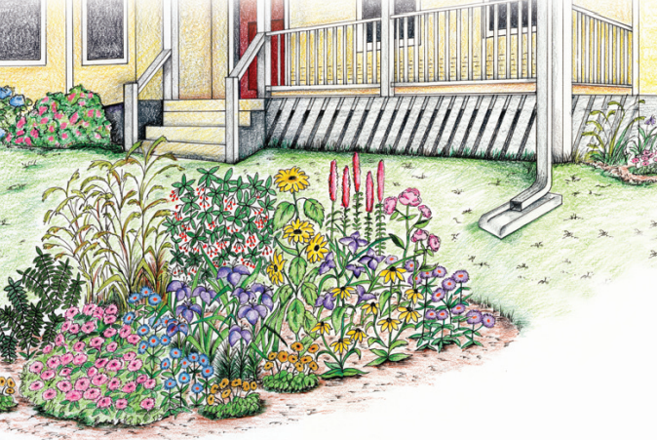
A not-very-illustrated primer on Low Impact Development (LID)

Slide 2

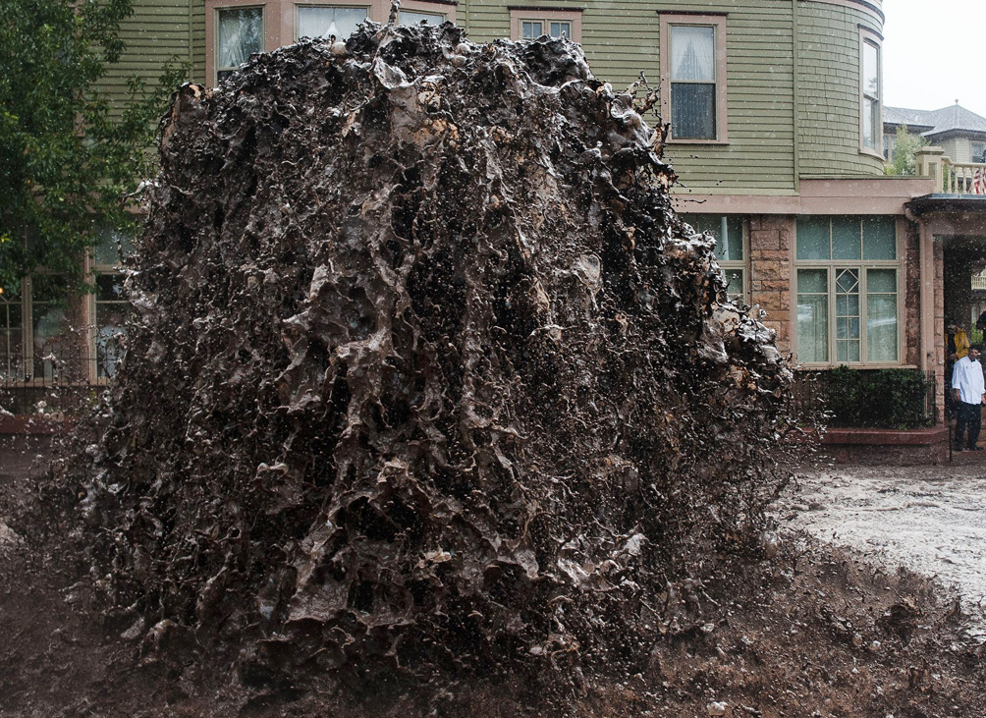
When last we left the land use/water resource connection…

Slide 3
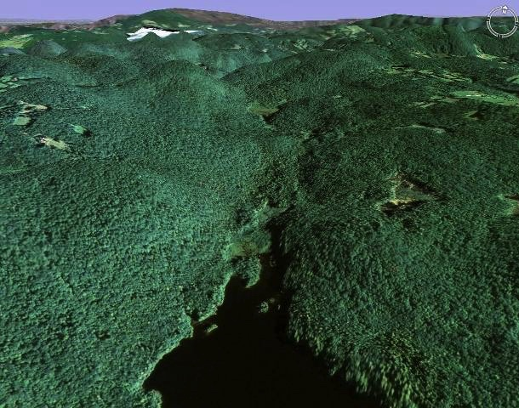
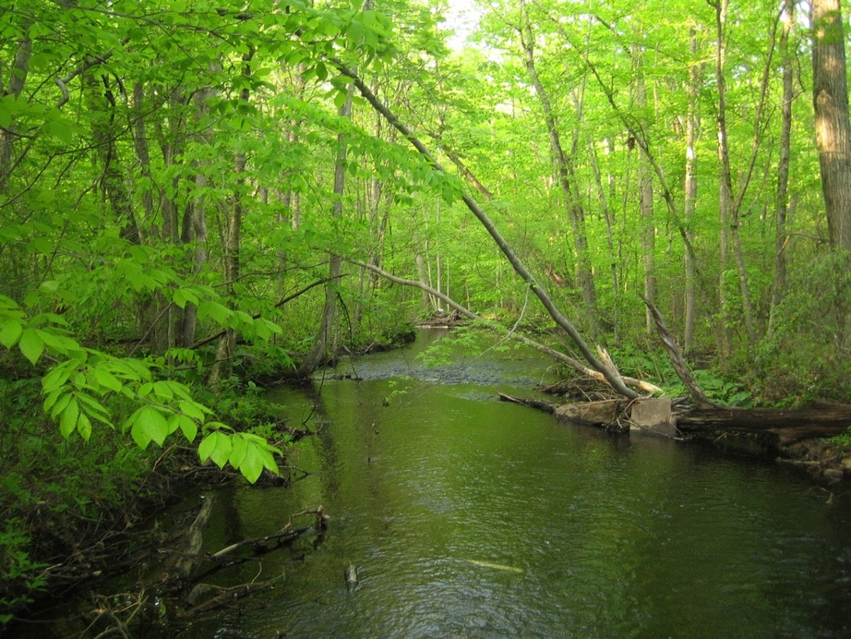
Notes:
Natural Stream
As an example of this, first note the characteristics of a well-protected stream:
- natural stream form
- alternating pools and riffles important to habitat
- stable stream banks that can withstand normal fluctuations in flow that you get with storms and droughts, wet and dry periods
- steady temperature fluctuations
- low levels of pollutants
The Urbanized Stream
Compare the last stream with this urban stream that's been impacted by development:
- unnatural form: much straighter, narrower
- pools and riffles disappear
- banks no longer stable--need to be reinforced
- temperature fluctuations much greater, which threatens sensitive aquatic organisms
- dramatic increase in the level of pollutants
Those pollutants are what we're going to focus on to better understand what's polluting our water everyday and how it is getting there from the things we do on the land.

Slide 4
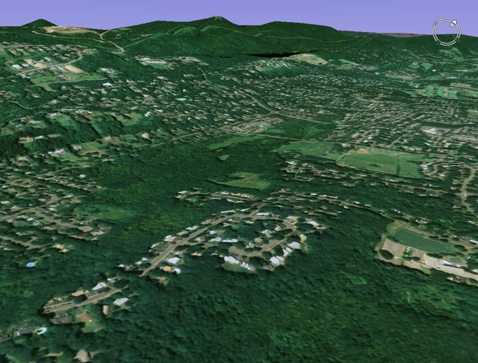
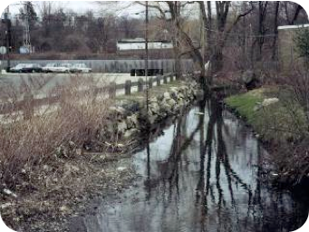
Notes:
Natural Stream
As an example of this, first note the characteristics of a well-protected stream:
- natural stream form
- alternating pools and riffles important to habitat
- stable stream banks that can withstand normal fluctuations in flow that you get with storms and droughts, wet and dry periods
- steady temperature fluctuations
- low levels of pollutants
The Urbanized Stream
Compare the last stream with this urban stream that's been impacted by development:
- unnatural form: much straighter, narrower
- pools and riffles disappear
- banks no longer stable--need to be reinforced
- temperature fluctuations much greater, which threatens sensitive aquatic organisms
- dramatic increase in the level of pollutants
Those pollutants are what we're going to focus on to better understand what's polluting our water everyday and how it is getting there from the things we do on the land.

Slide 5
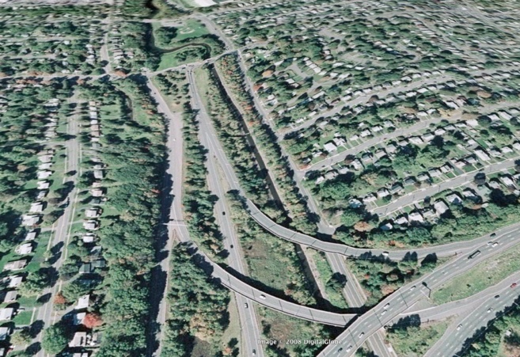
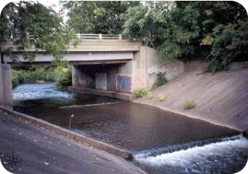
Notes:
Natural Stream
As an example of this, first note the characteristics of a well-protected stream:
- natural stream form
- alternating pools and riffles important to habitat
- stable stream banks that can withstand normal fluctuations in flow that you get with storms and droughts, wet and dry periods
- steady temperature fluctuations
- low levels of pollutants
The Urbanized Stream
Compare the last stream with this urban stream that's been impacted by development:
- unnatural form: much straighter, narrower
- pools and riffles disappear
- banks no longer stable--need to be reinforced
- temperature fluctuations much greater, which threatens sensitive aquatic organisms
- dramatic increase in the level of pollutants
Those pollutants are what we're going to focus on to better understand what's polluting our water everyday and how it is getting there from the things we do on the land.

Slide 6
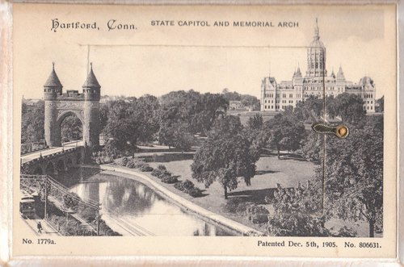
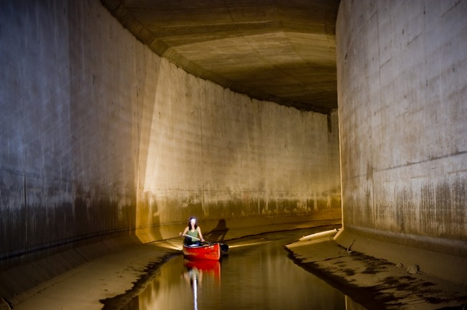
The urban endpoint

Slide 7
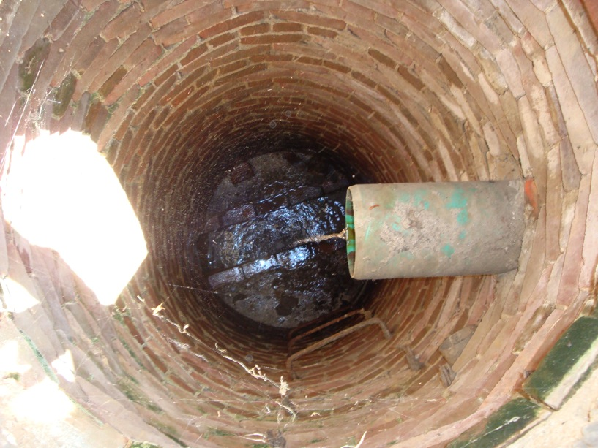
Urban endpoint, UConn-style
Eagleville Brook

Slide 8
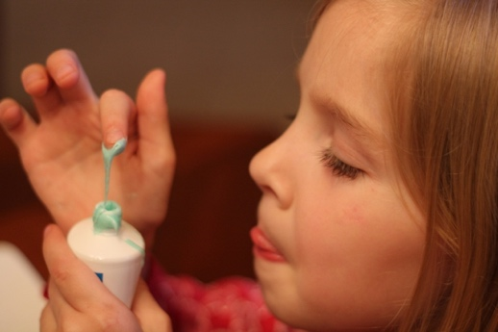
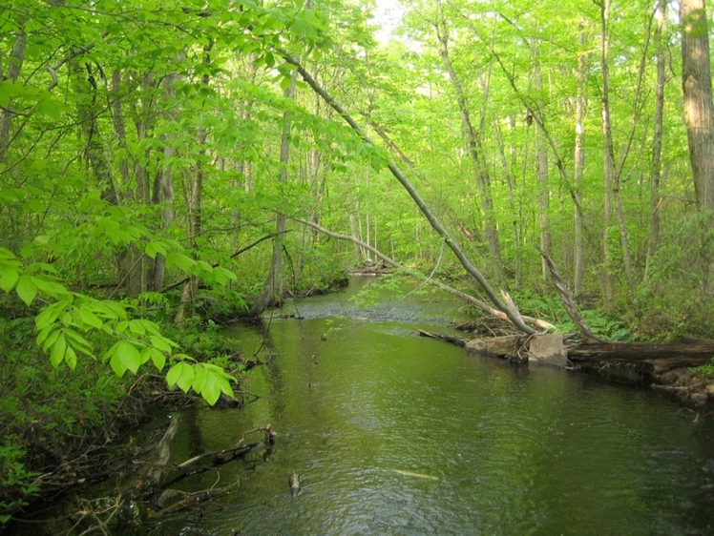
The question is…
?

Slide 9
1. What’s the concept?
LID Practices
2. Do they work?
3. What do they look like?
4. Who is using them (and why)?

Slide 10
1. What’s the concept?
LID Practices
2. Do they work?
3. What do they look like?
4. Who is using them (and why)?

Slide 11
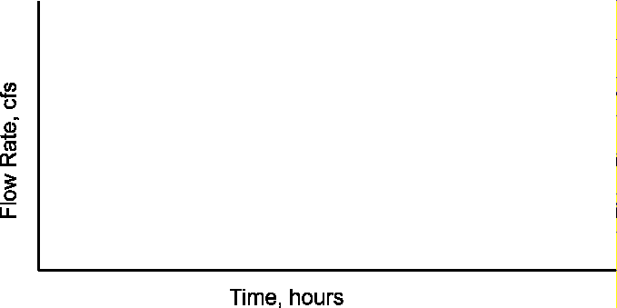
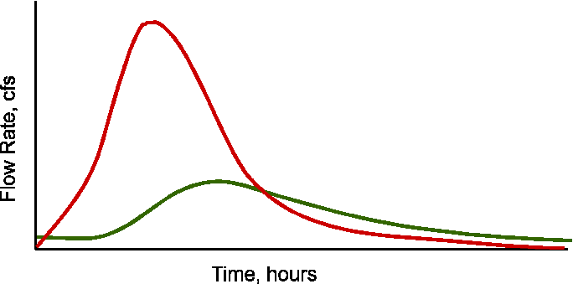
Low Impact Development (LID)
A site design strategy intended to maintain or replicate a site’s natural hydrology systems through the use of small-scale controls integrated throughout the site to manage runoff as close to its source as possible.

Slide 12
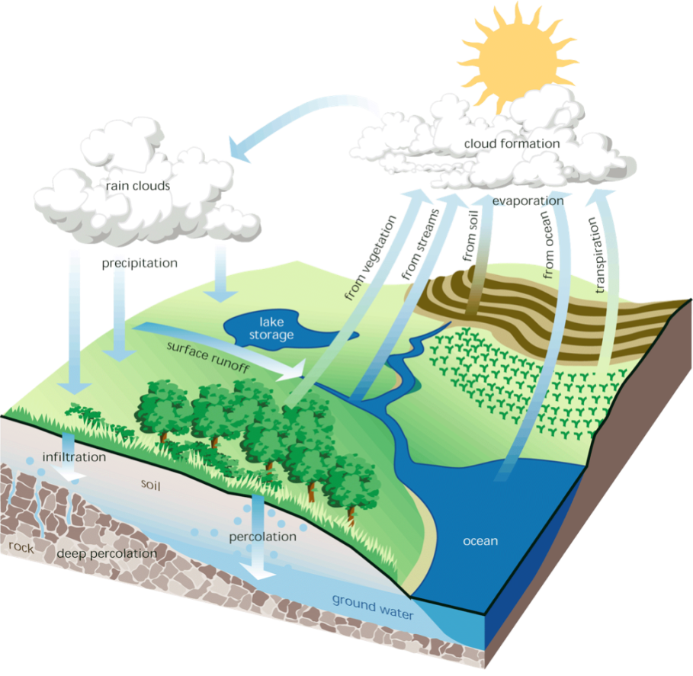
LID Goal:
To preserve pre-development hydrology
  Runoff volume and rate
  Groundwater recharge
  Stream base flow
  Runoff water quality

Slide 13


A Terminological Interlude…
LOW IMPACT DEVELOPMENT
  Site level practices designed to treat and infiltrate water
GREEN INFRASTRUCTURE
  same as LID, or
  site level + landscape level strategies like riparian corridor restoration & open space conservation
GREEN STORMWATER INFRASTRUCTURE

Slide 14
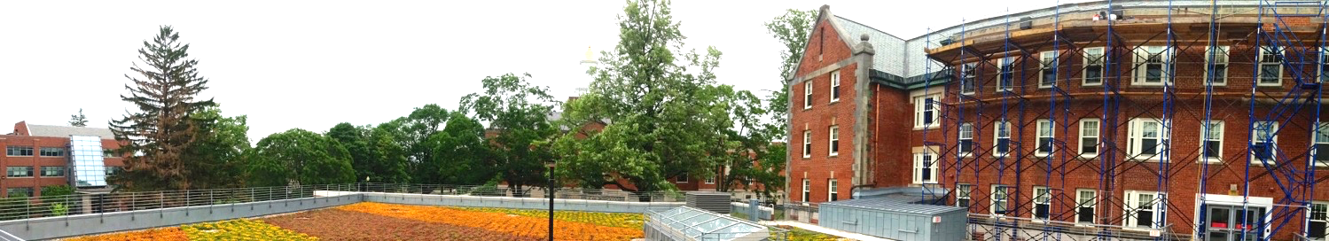
LID Practices
Rain gardens & bioretention basins
Vegetated swales & “green streets”
Green roofs
Rainwater harvesting
Tree box filters
Permeable pavements

Slide 15


And as long as we’re on terminology…
BIORETENTION
Commercial applications: engineered design, modified soils, usually have underdrains, overflow provision
RAIN GARDENS
Home-scale, not typically engineered, use existing soils

Slide 16

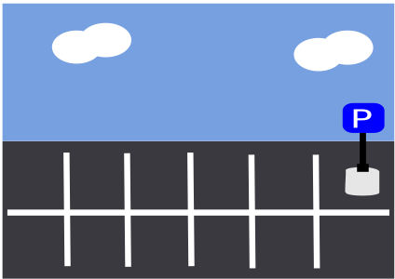
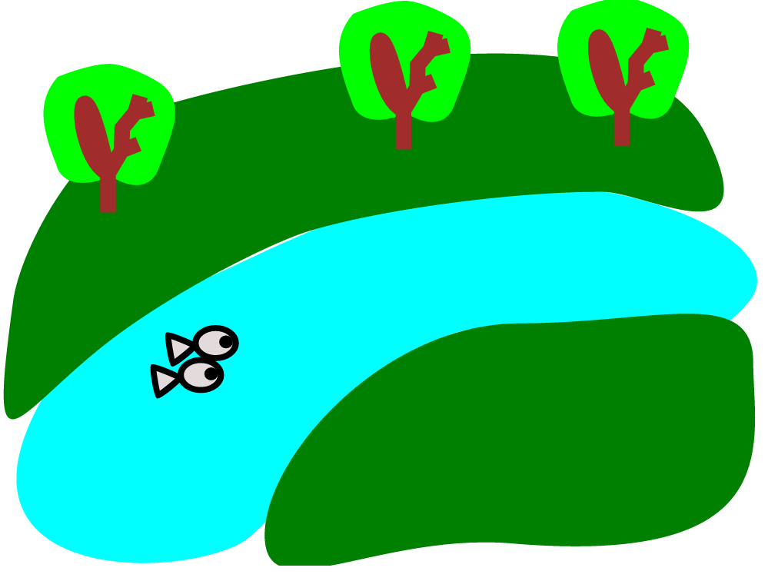
The main LID technique is DISCONNECTION of impervious surfaces

Slide 17
What’s going on in there?
Reduction in stormwater volume
  Infiltration
  Evapotranspiration
Filtration of coarse particles
  Sediment
Pollutants retained/processed
  Taken up by plants (nitrogen, phosphorus)
  Adsorbed to mulch, soils, or organic matter (metals, N, P)
  Broken down by microorganisms and sunlight (hydrocarbons, bacteria)
  Converted to gaseous form

Slide 18
1. What’s the concept?
LID Practices
2. Do they work?
3. What do they look like?
4. Who is using them (and why)?

Slide 19
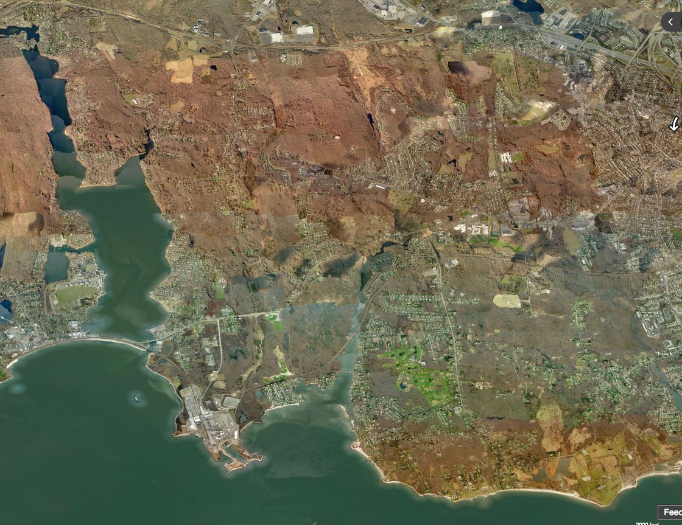
The Jordan Cove Research Project
Waterford, CT, 1995 - 2005
Giovanni Drive subdivision
Niantic Bay
Jordan Cove

Slide 20
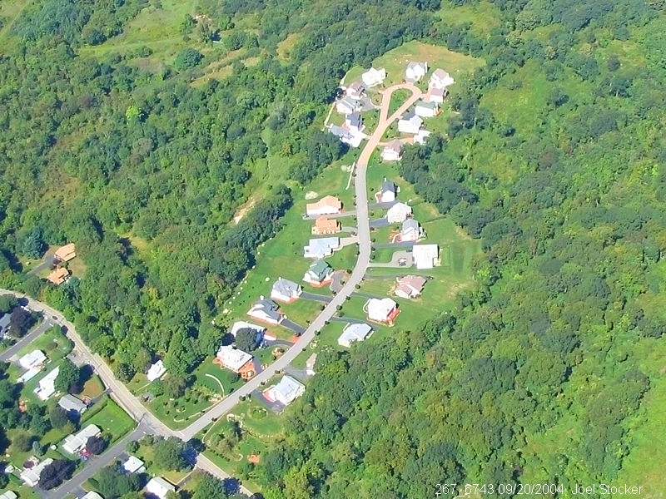
A “Paired Watershed” Approach
involving intensive monitoring
LID Cluster
Conventional

Slide 21

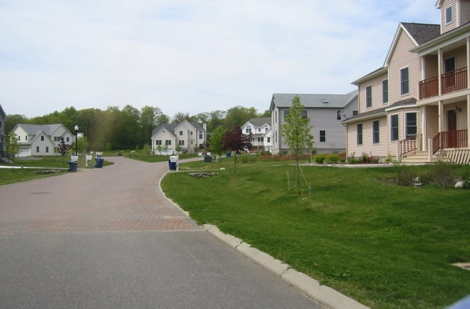
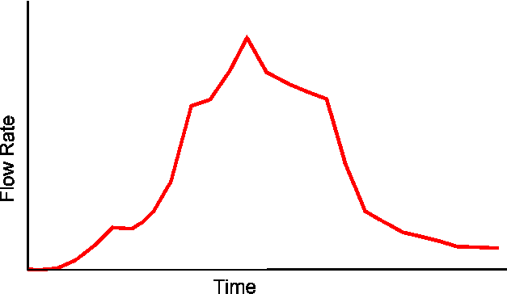
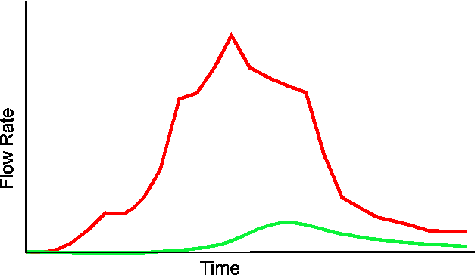
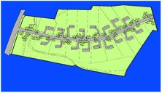
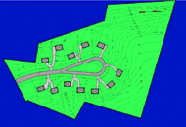
Jack Clausen’s $ 1M graph…
LID
Conventional
Adapted from J. Clausen, UConn

Slide 22
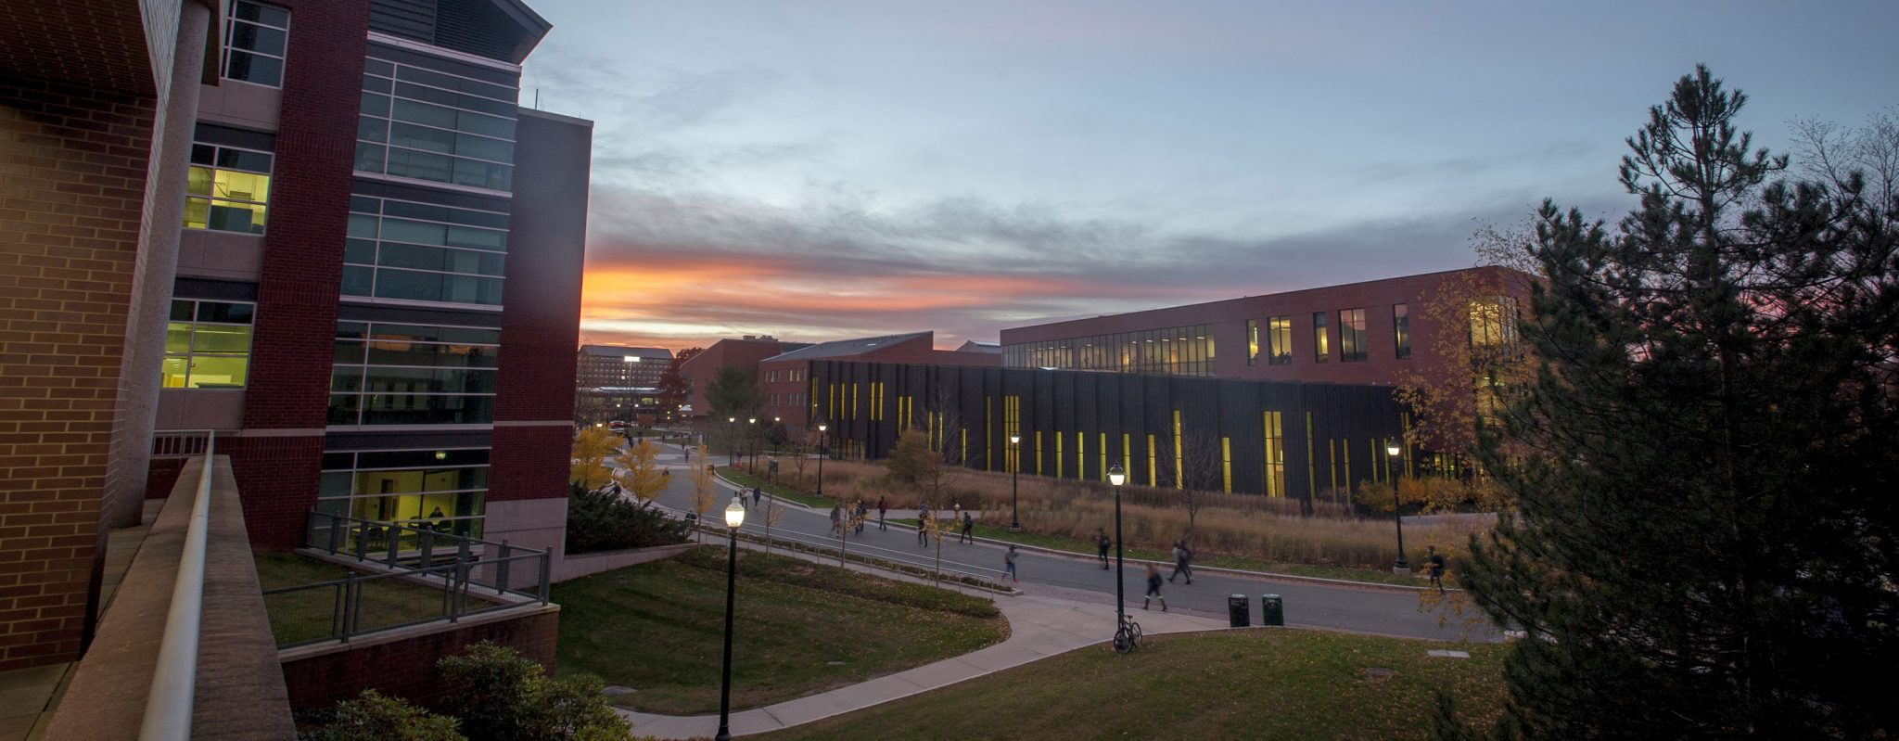
And do they work on campus?

Slide 23
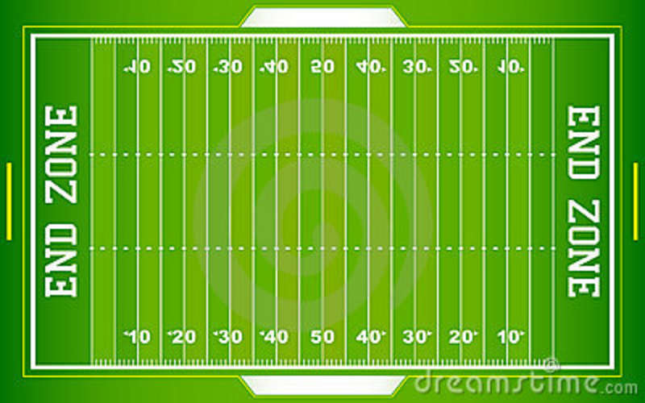
Total area of impervious cover disconnected by campus LID practices
8.5 X
(11+ acres)

Slide 24
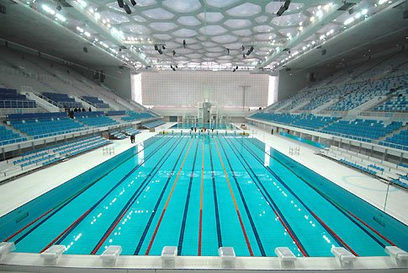
Cumulative volume of stormwater reduction by campus LID practices
88 x
(58,325,000 gallons)

Slide 25
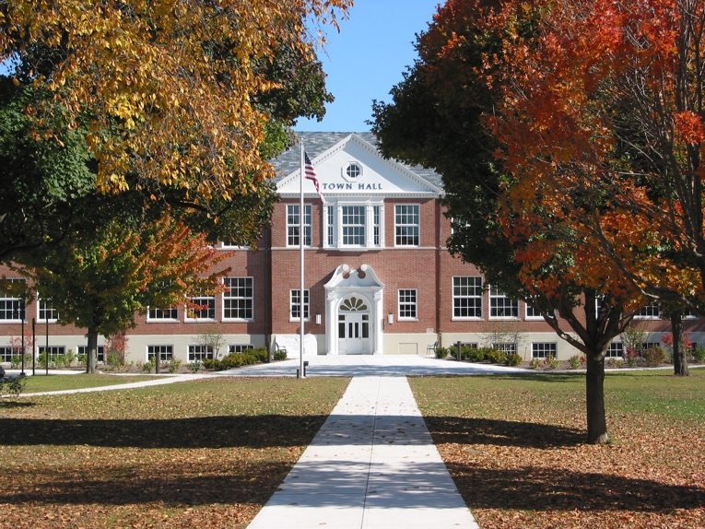
Things that come up in the LID conversation
do they work?
do they work in the winter?
do they cost more?
how are they maintained?
[your favorite here…]

Slide 26
1. What’s the concept?
LID Practices
2. Do they work?
embargoed!!!
3. What do they look like?
4. Who is using them (and why)?

Slide 27
1. What’s the concept?
LID Practices
2. Do they work?
3. What do they look like?
4. Who is using them (and why)?
this afternoon!!!

Slide 28
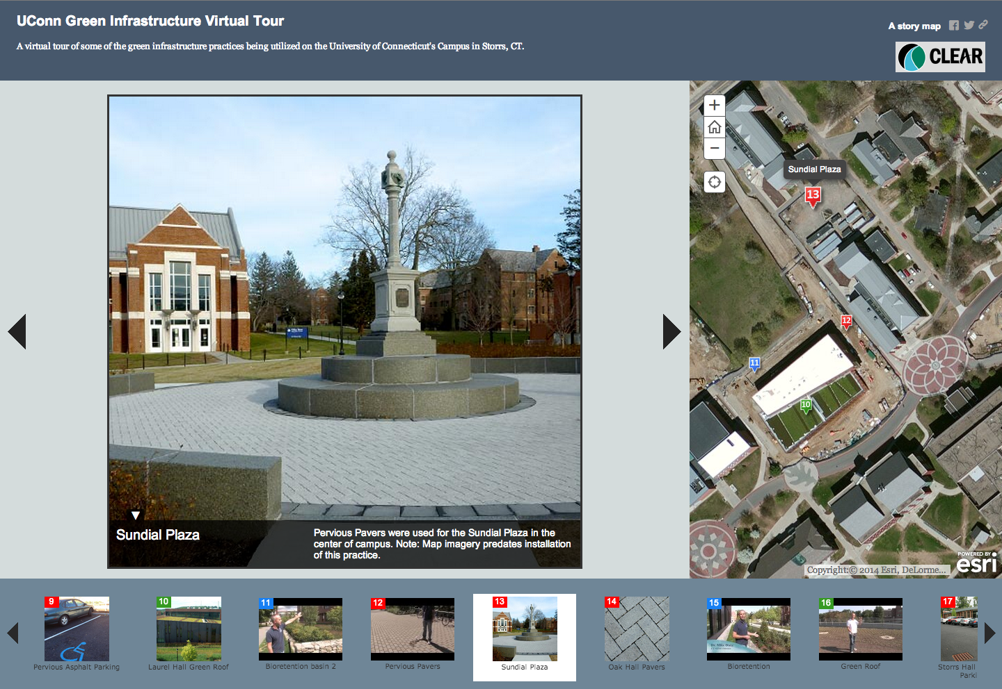
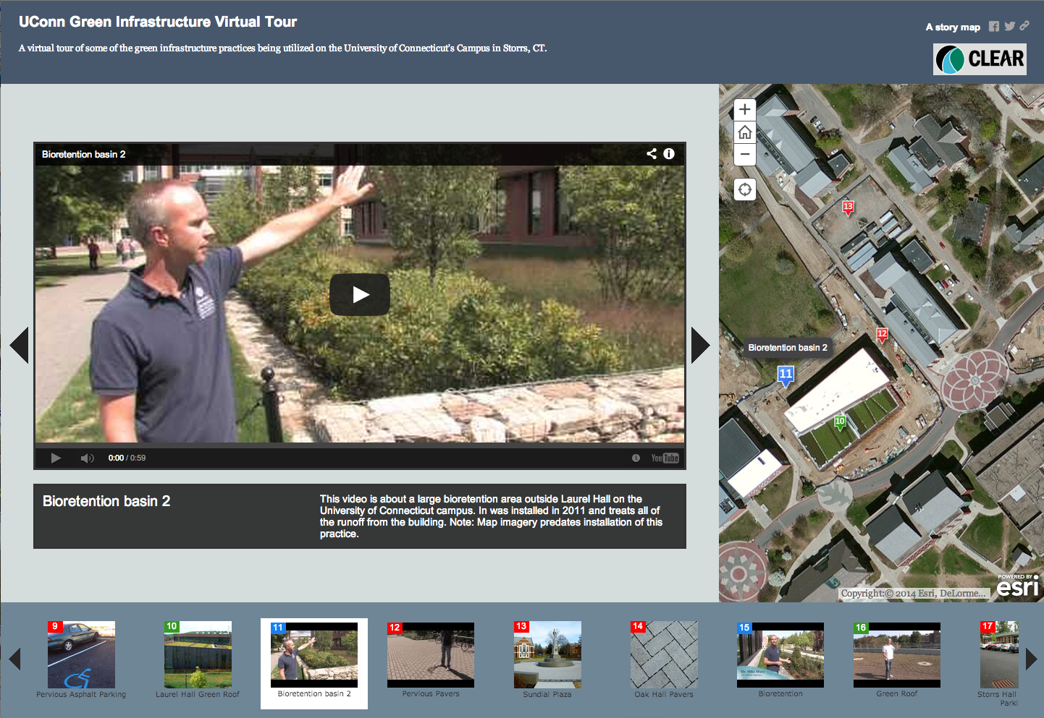
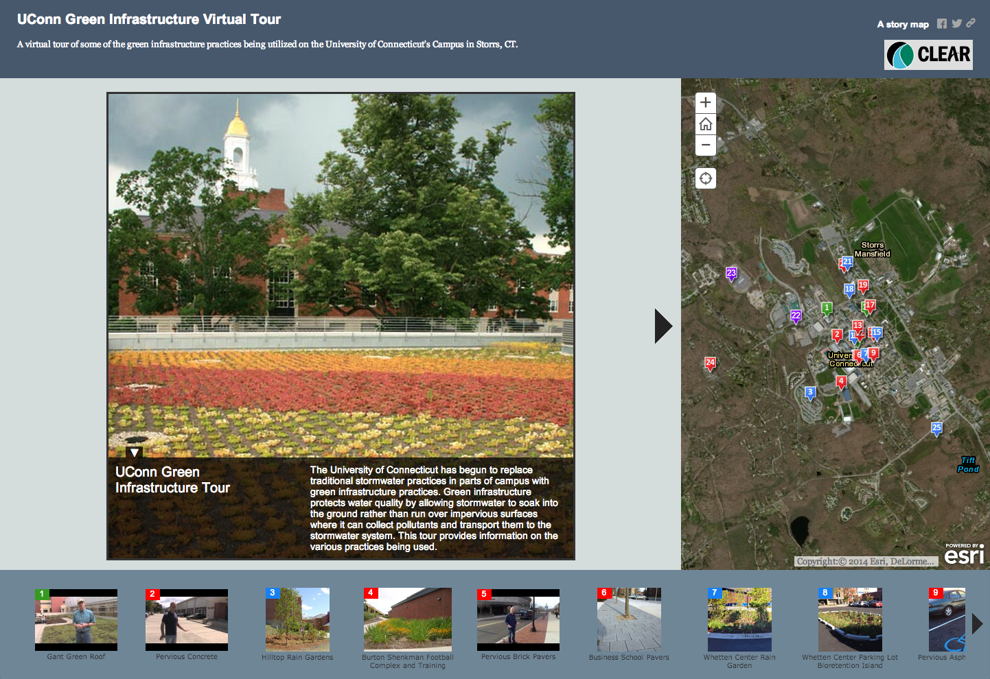
Interactive Campus LID Tour
(yet another story map)

Slide 29
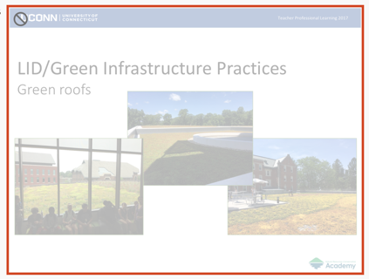
And in the posted PPT there are a few of these…

Slide 30
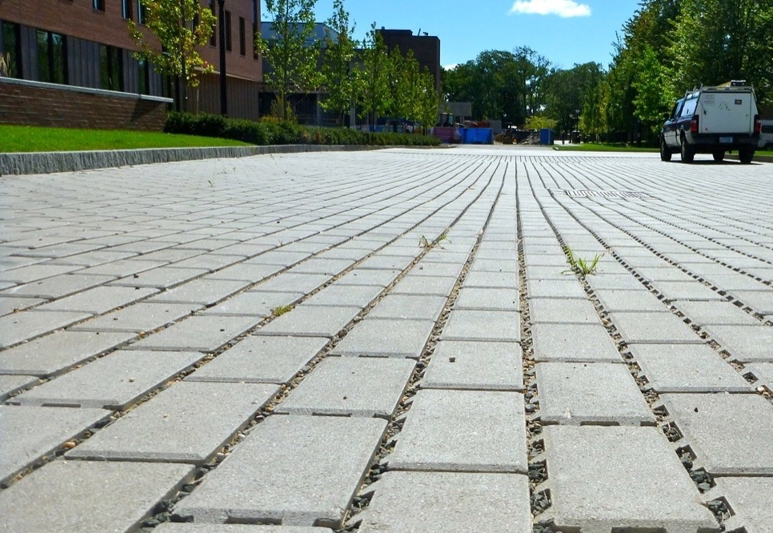
time to hit the bricks
PICPs

Slide 31
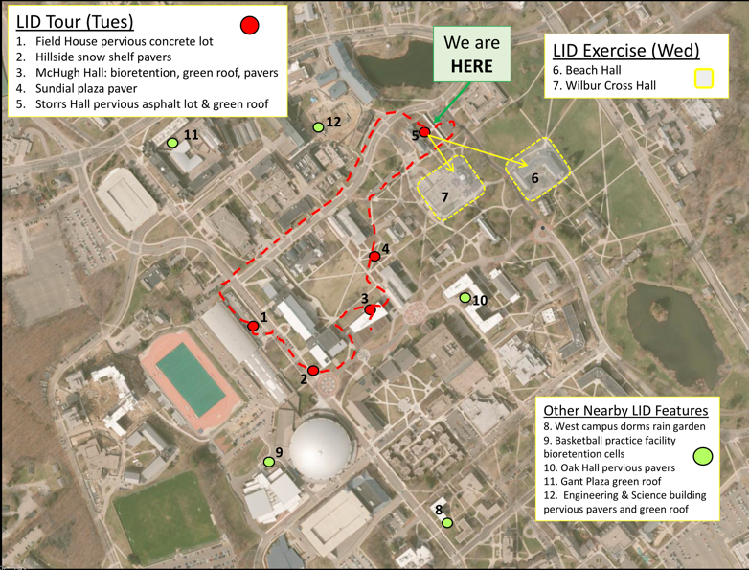
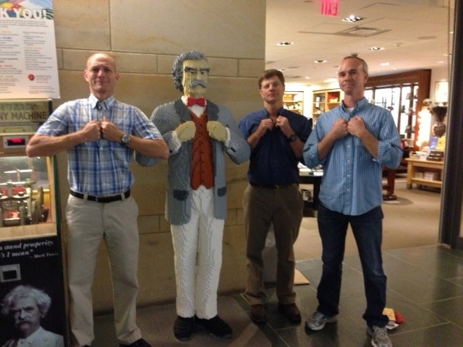
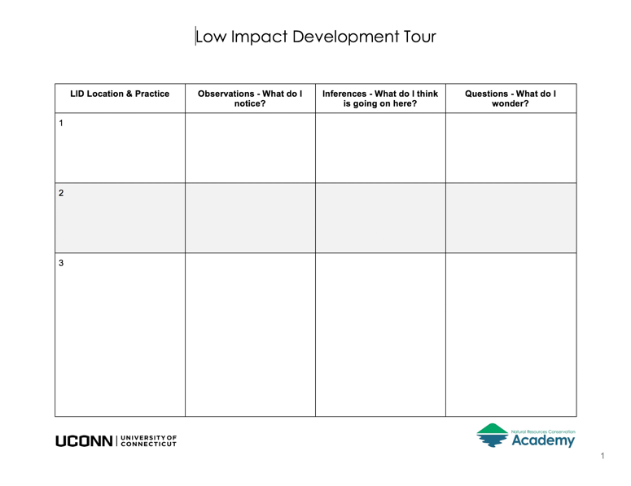
To take with you:
Your fearless guides

Slide 32
Following are slides of various LID practices on the UConn campus, as an illustrated guide for those who cannot visit.
And don’t forget the online campus LID tour

Slide 33
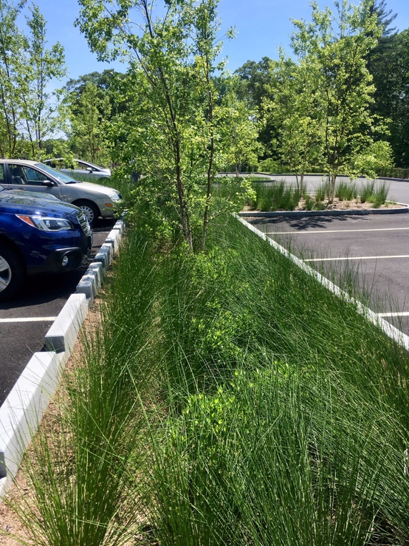
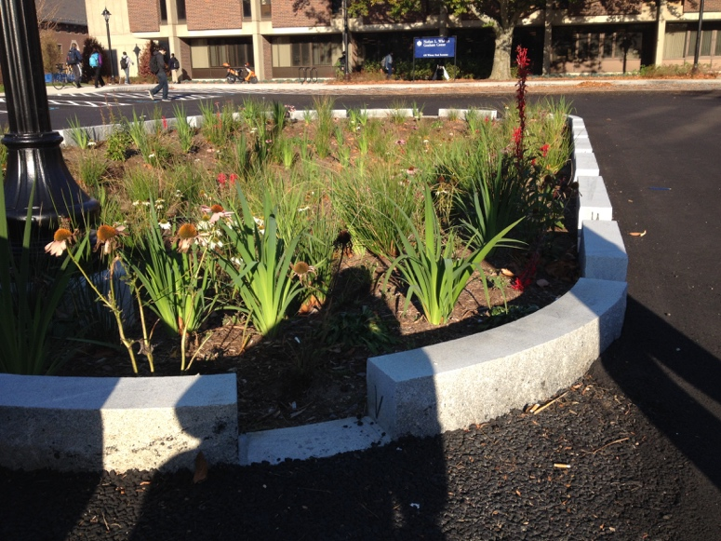
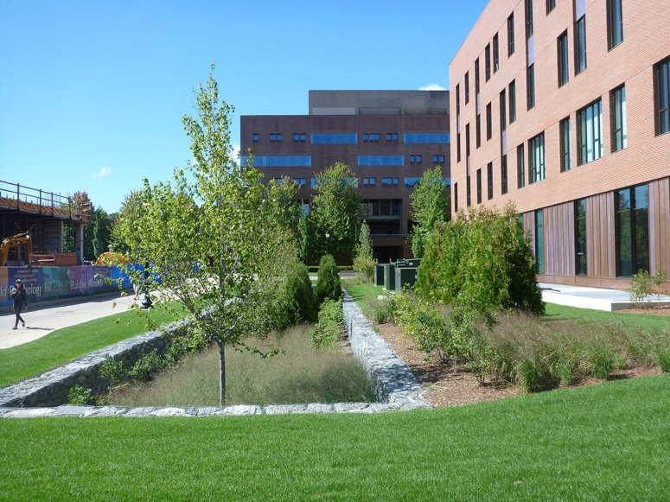
Bioretention/rain gardens
LID/Green Infrastructure Practices

Slide 34
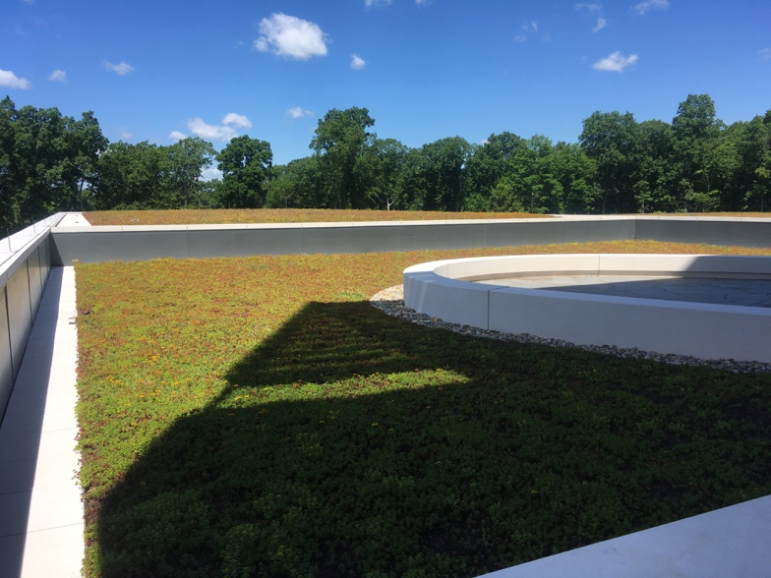
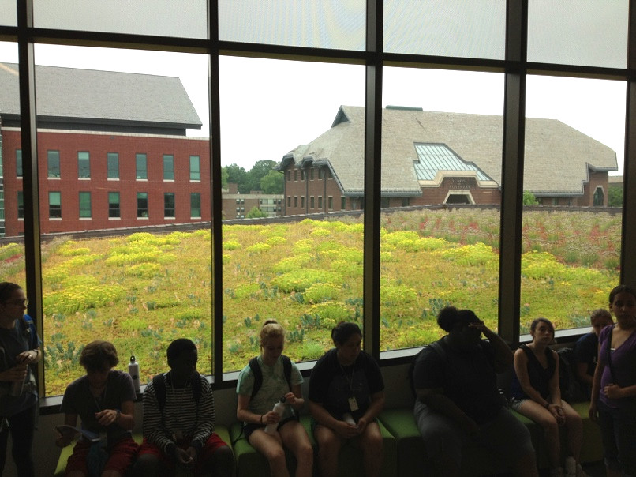
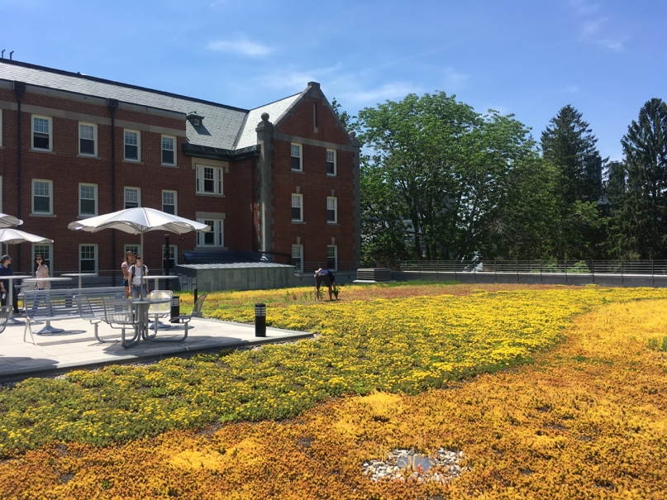
LID/Green Infrastructure Practices
Green roofs
Stamford, CT
Ledyard, CT

Slide 35
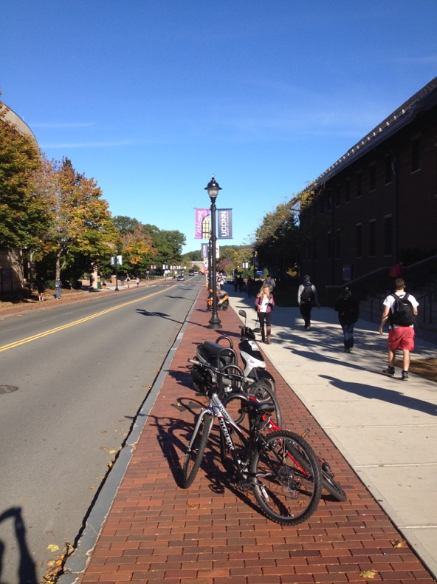
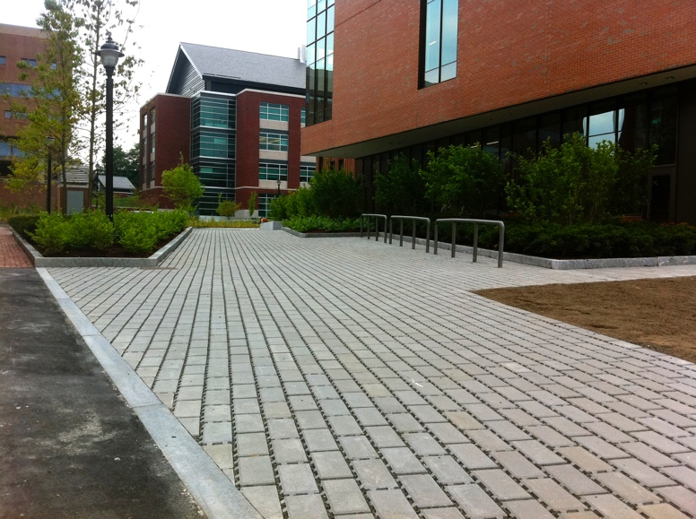
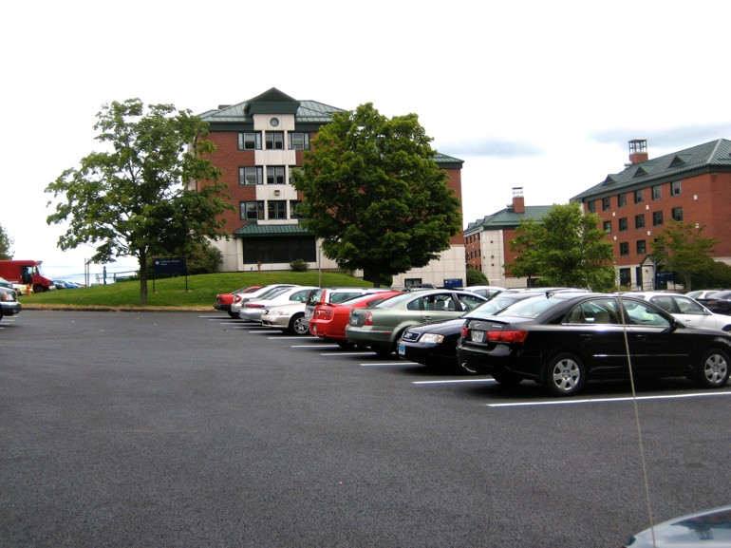
Permeable Pavements
LID/Green Infrastructure Practices
Notes:
Villanova

Slide 36
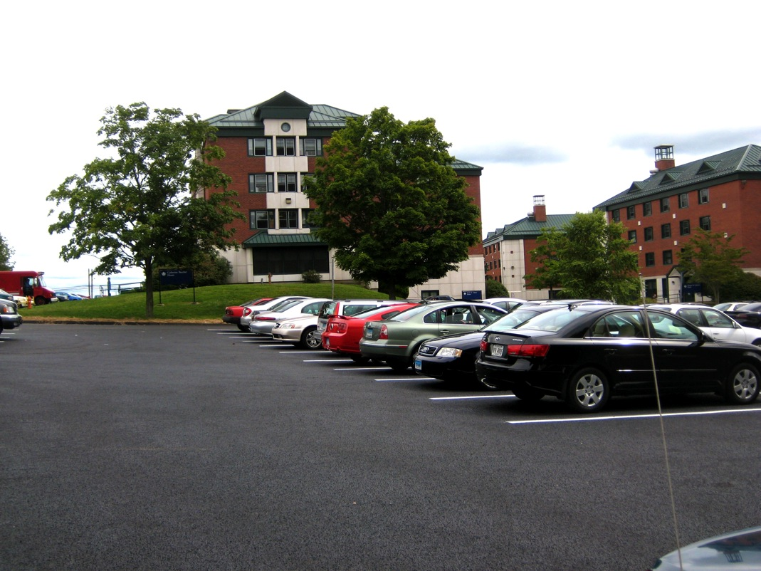
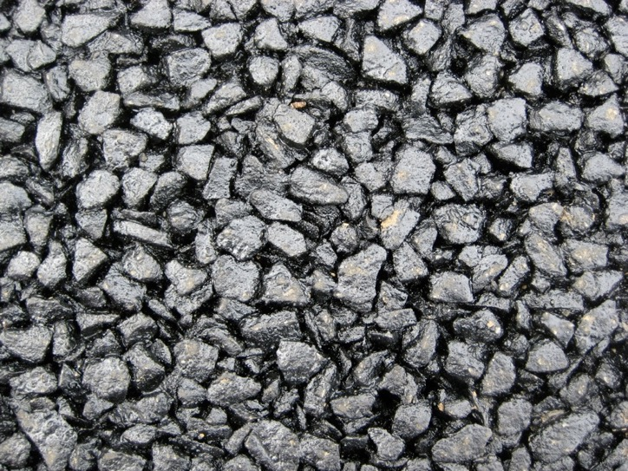
2009
Towers Pervious Asphalt Lot

Slide 37
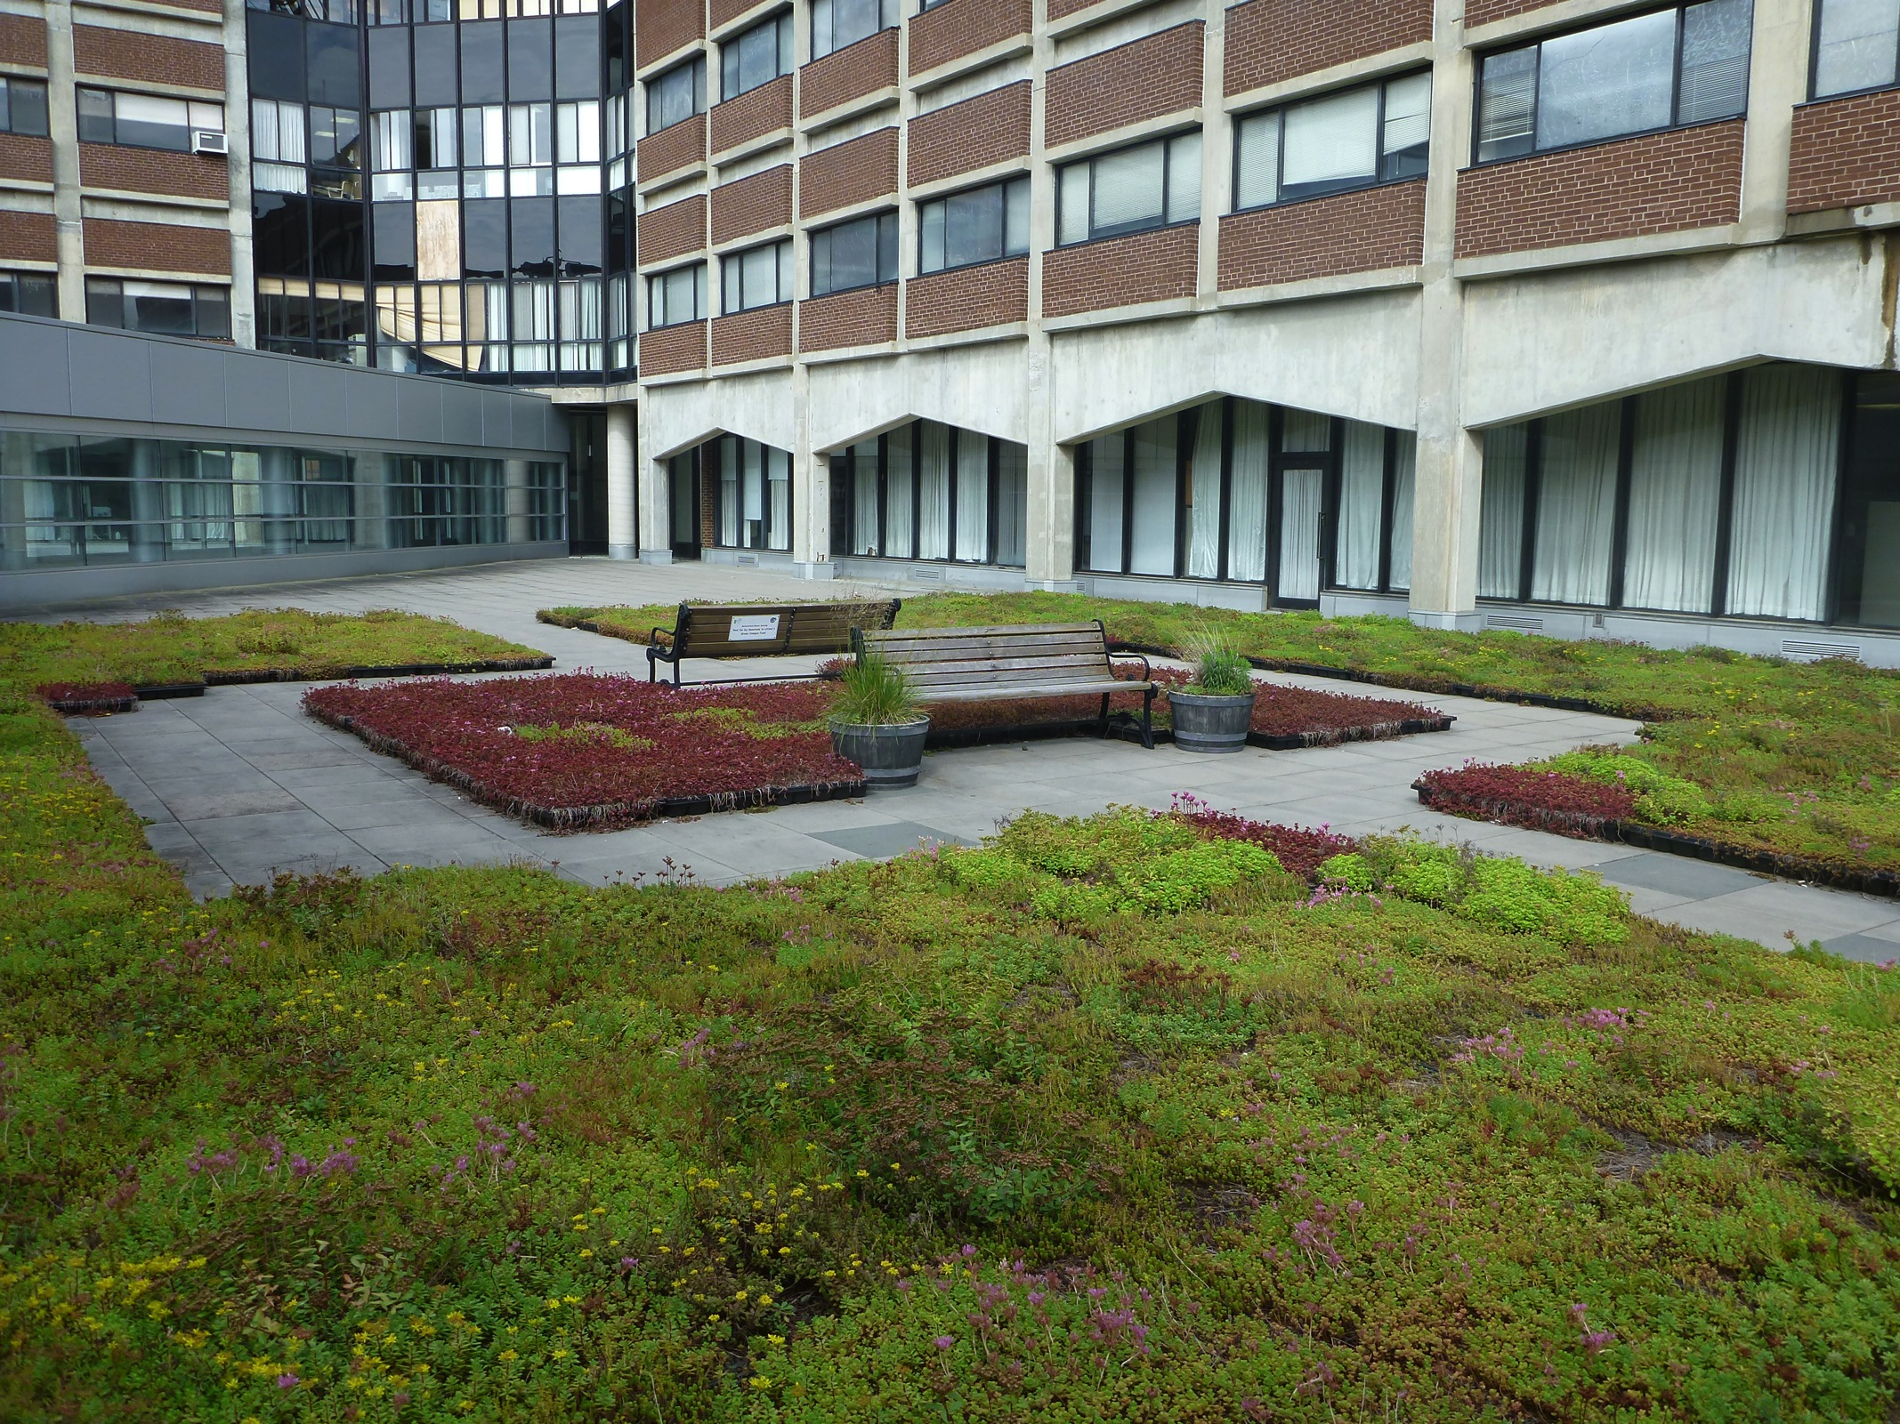
2009
Gant Plaza Green Roof

Slide 38

2011
McHugh Hall green roof

Slide 39

2011
McHugh Hall bioretention

Slide 40




2011
McHugh Hall permeable pavers

Slide 41

2012
Oak Hall bioretention

Slide 42

2012
Oak Hall permeable pavers

Slide 43


2013
Hillside Rd snow shelf permeable pavers

Slide 44

2013
Rain Garden at Whetten Hall (since removed during construction of new building).

Slide 45


Storrs Hall green roof 2013

Slide 46

Tree Filters (2014-15)

Slide 47


Basketball practice bioretention (2015)

Slide 48


New Engineering & Science Building
Green roof and pavers
2017

Slide 49


Innovation Partnership Building
2018
Bioretention + green roof(s)

