Slide 1
Mapbook of xxxx
Town, CT
By Your Name
Notes:
Add the title and author
Add a picture if you have one

Slide 2
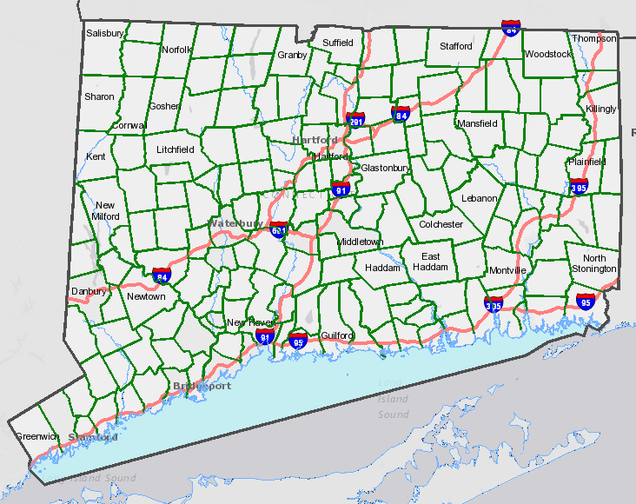
Index
Map 1: Spring Aerial Imagery
Map 2: Hillshade Elevation
Map 3: Boundaries/Streets
Map 4: Hydric Soils
Map 5: Farmland Soils
Map 6: Open Space
Map 7: Critical Habitat & Natural Diversity DB Areas
Map 8: Watersheds, Hydrography & Wellhead protection areas
Map 9: Water Quality: Surface & Groundwater
Notes:
Move the star to your location

Slide 3
2016 Spring Aerial Imagery
Flight managed the Capitol Region Council of Governments and funded by the CT Office of Policy and Management with contributions from the CT Dept. of Transportation and CT Dept. of Emergency Services and Public Protection.
3 inch pixels
More information on http://cteco.uconn.edu/data/flight2016/
Notes:
Go to the CT ECO website http://cteco.uconn.edu
Find Map Viewers.
Find CT ECO Aerial Imagery Viewer and click Go to Viewer.
Click on the Layers button in the upper right-hand corner to see all of the available layers.
Click on the 2016 Color Spring 3inch and UNCHECK any layers above it.
Take a snip, copy and paste on the slide 2016 Spring Aerial Imagery. Resize or crop if necessary.

Slide 4
Hillshade
Elevation from Lidar and displayed as hillshade. Hillshade is a grayscale view of terrain that considers the sun’s relative position.
More information on the CT ECO website http://cteco.uconn.edu/data/lidar/
Notes:
Return to the CT ECO website http://cteco.uconn.edu
Find Map Viewers.
Find Elevation (Lidar) Viewer and click Go to Viewer.
Zoom to your location.
Take a snip, copy and paste on the slide Hillshade. Resize or crop if necessary.

Slide 5
Boundaries & Streets
Base map information including airport, railroad, waterbody, watercourse and town boundary information.
Based on the most recently published 1:24,000-scale U.S. Geological Survey topographic quadrangle maps.
More information on http://cteco.uconn.edu.
Notes:
Go to the CT ECO website http://cteco.uconn.edu.
Find Map Viewers.
Find Simple Viewer and click Go to Viewer.
Zoom to your location.
Take a snip, copy and paste on the slide the default Towns layer. Resize or crop if necessary.

Slide 6

Hydric Soils
Hydric soils are soils formed under conditions of saturation, flooding, or ponding long enough during the growing season to support the growth and reproduction of hydrophytic vegetation.
More information on the CT ECO website http://cteco.uconn.edu/guides
Notes:
Go to the CT ECO website http://cteco.uconn.edu
Find Map Viewers.
Find the Simple Map Viewer and click Go to Viewer.
Locate the Layers tab in the lower left.
Zoom to your location.
Click on the radio button next to Soils and then the radio button next to Hydric Soils. If a different soils layer is more relevant to your project, such as farmland or flooding, use it. Be sure to update the slide text.
Change the Basemap (lower right of the layer list) to Spring Aerial.
Take a snip, copy and paste on the slide Hydric Soils. Resize or crop if necessary.

Slide 7
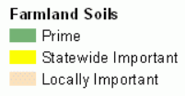
Farmland Soils
Farmland Soils includes land that is defined as prime, unique, or farmland of statewide or local importance. It identifies the location and extent of the most suitable land for producing food, feed, fiber, forage, and oilseed crops.
More information on the CT ECO website http://cteco.uconn.edu/data/lidar/
Notes:
Go to the CT ECO website http://cteco.uconn.edu
Find Map Viewers.
Find the Simple Map Viewer and click Go to Viewer.
Locate the Layers tab in the lower left.
Zoom to your location.
Click on the radio button next to Soils and then the radio button next to Farmland Soils. If a different soils layer is more relevant to your project, such as farmland or flooding, use it. Be sure to update the slide text.
Change the Basemap (lower right of the layer list) to Spring Aerial.
Take a snip, copy and paste on the slide Farmland Soils. Resize or crop if necessary.

Slide 8
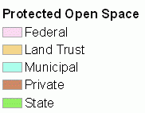
Open Space
Protected Open Space in an inventory of open space as defined by the Department of Environmental Protection Protected Open Space Mapping (POSM) project. These include: land or interest in land acquired for the protection of natural features of the state's landscape or essential habitat for endangered or threatened species; and land or an interest in land acquired to support and sustain non-facility-based outdoor recreation, forestry and fishery activities, or other wildlife or natural resource conservation or preservation activities.
Data is not included for every town in Connecticut because information is collected by DEEP from individual towns on an ongoing basis.
More information on the CT ECO website http://cteco.uconn.edu/guides
Notes:
Go to the CT ECO website http://cteco.uconn.edu
Find Map Viewers.
Find the Simple Map Viewer and click Go to Viewer.
Locate the Layers tab in the lower left.
Zoom to your location.
Click on the radio button next to Open Space and then the radio button next to Protected Open Space Mapping.
Change the Basemap (lower right of the layer list) to Spring Aerial.
Take a snip, copy and paste on the slide Open Space. Resize or crop if necessary.

Slide 9
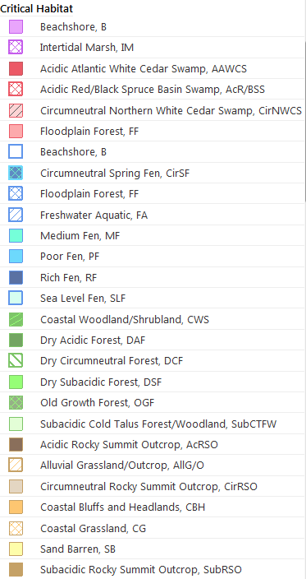
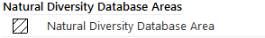
Critical Habitat & Natural Diversity DB Areas
Critical Habitat from the CT Dept. of Energy and Environmental Protection. More information in the CT ECO Data Guide http://cteco.uconn.edu/guides/Critical_Habitat.htm.
Natural Diversity Database from the CT Dept. of Energy and Environmental Protection. More information in the CT ECO Data Guide http://cteco.uconn.edu/guides/Natural_Diversity_Database.htm
Notes:
Go to the CT ECO website http://cteco.uconn.edu
Find Map Viewers.
Find the Advanced Map Viewer and click Go to Viewer. The viewer is a draft so click the Advanced Viewer link in the text.
Expand the + next to Bioscience and click on
Critical Habitat and
Natural Diversity Database Area
Change the Basemap back to the original Basemap.
Take a snip, copy and paste on the slide Critical Habitat & Natural Diversity DB Areas. Resize or crop if necessary.

Slide 10


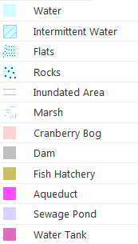

Water Resources
Watersheds from the CT Dept. of Energy and Environmental Protection. More information in the CT ECO Data Guide http://cteco.uconn.edu/guides/Local_Basin.htm.
Hydrography from the USGS.
Wellhead Protection Areas is from CT DEEP.
Basemap is Hillshade derived from Lidar.
Notes:
Return to the Advanced Map Viewer and uncheck the layers you had turned on under the Bioscience group.
Expand the + next to Watersheds and click on
DEEP Regional Basins,
DEEP Subregional Basins and
DEEP Local Basins.
Expand the + next to Water Resources and click on
Hydrography and
Wellhead Protection Areas.
Change the Basemap back to Hillshade.
Take a snip, copy and paste on the slide Water Resources. Resize or crop if necessary.

Slide 11
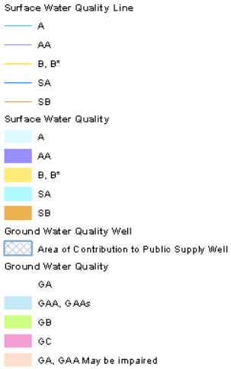
Water Quality
Surface and ground water quality classifications from the CT Dept. of Energy and Environmental Protection. More information in the CT ECO Data Guide http://cteco.uconn.edu/guides/water_quality_class.htm.
Basemap is Hillshade derived from Lidar.
Notes:
Return to the Advanced Map Viewer and uncheck the layers you had turned on under the Water Resources and Watersheds group.
Expand the + next to Water Quality and click on
Surface Water Quality and
Ground Water Quality
Change the Basemap back to Hillshade.
Take a snip, copy and paste on the slide Water Quality. Resize or crop if necessary.

