Slide 1
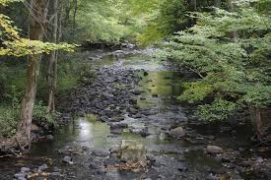
Human Impact on Local Water Resources:
An NGSS-Aligned High School Unit
Developed for the Teacher Professional Learning (TPL) Workshop:
A collaboration between the Natural Resources and Education Departments at the
University of Connecticut
NEAG SCHOOL OF EDUCATION

Slide 2
Presentation Overview
Part 1:
Brief Overview/Introduction of NGSS, and Three-Dimensional Learning as Sensemaking
Ambitious Science Teaching (AST) Framework
Unit Structure
NEAG SCHOOL OF EDUCATION
Notes:
Add discussion of AST - 4 practices.

Slide 3


Framework and NGSS
The Framework for K-12 Science Education formed the basis for development of the Next Generation Science Standards.

Slide 4
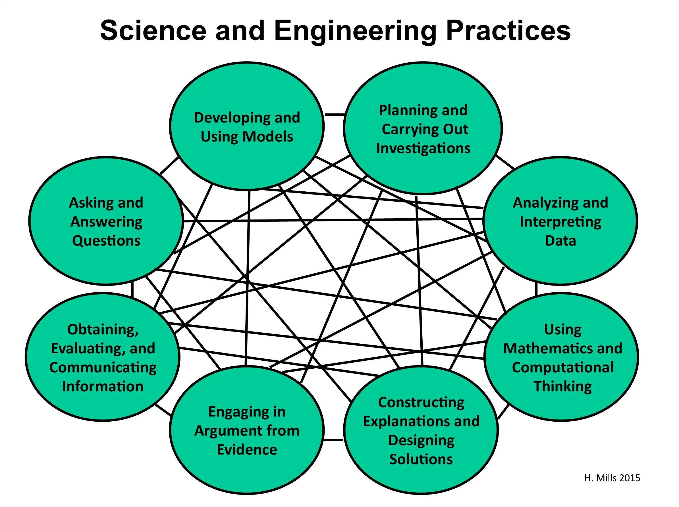
Science & Engineering Practices (SEPs)
‹#›
Notes:
Berland (2011) describes practices as the habits of mind and processes undertaken by communities of scientists as they work to develop explanations and arguments for explaining natural phenomena and/or leverage science for making informed decisions as citizens.
Berland (2011) describes practices as the habits of mind and processes undertaken by communities of scientists as they work to develop explanations and arguments for explaining natural phenomena and/or leverage science for making informed decisions as citizens.
11) describes practices as the habits of mind and processes undertaken by communities of scientists as they work to develop explanations and arguments for explaining natural phenomena and/or leverage science for making informed decisions as citizens.
Berland (2011) describes practices as the habits of mind and processes undertaken by communities of scientists as they work to develop explanations and arguments for explaining natural phenomena and/or leverage science for making informed decisions as citizens.
Berland (2011) describes practices as the habits of mind and processes undertaken by communities of scientists as they work to develop explanations and arguments for explaining natural phenomena and/or leverage science for making informed decisions as citizens.
Berland (2011) describes practices as the habits of mind and processes undertaken by communities of scientists as they work to develop explanations and arguments for explaining natural phenomena and/or leverage science for making informed decisions as citizens.
Berland (2011) describes practices as the habits of mind and processes undertaken by communities of scientists as they work to develop explanations and arguments for explaining natural phenomena and/or leverage science for making informed decisions as citizens.

Slide 5
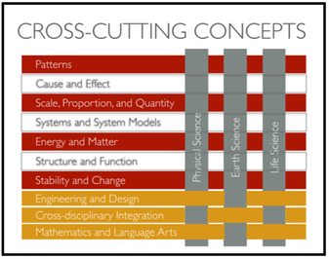
Crosscutting Concepts (CCCs)
‹#›
Notes:
CCCCs provide students with connections and intellectual tools that are related across the differing areas of disciplinary content and can enrich their application of practices and their understanding of core ideas. — Framework p. 233

Slide 6

Disciplinary Core Ideas (DCIs)
Earth Science - ESS3.C: Human Impacts on Earth Systems
The sustainability of human societies and the biodiversity that supports them requires responsible management of natural resources.
Scientists and engineers can make major contributions by developing technologies that produce less pollution and waste and that preclude ecosystem degradation.
Notes:
Disciplinary Core Ideas:
Have broad importance across multiple science or engineering disciplines or is a key organizing concept of a single discipline
Provide key tools for understanding or investigating more complex ideas and solving problems
Relate to the interests and life experiences of students or can be connected to societal or personal concerns that require scientific or technical knowledge
Are teachable and learnable over multiple grades at increasing levels of depth and sophistication

Slide 7

Disciplinary Core Ideas (DCIs)
Life Science - LS2.C: Ecosystem Dynamics, Functioning, and Resilience
Moreover, anthropogenic changes (induced by human activity) in the environment—including habitat destruction, pollution, introduction of invasive species, overexploitation, and climate change—can disrupt an ecosystem and threaten the survival of some species.
‹#›

Slide 8
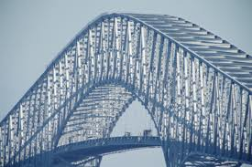
Disciplinary Core Ideas (DCIs)
Engineering Design - ETS1.B: Developing Possible Solutions
When evaluating solutions it is important to take into account a range of constraints including cost, safety, reliability and aesthetics and to consider social, cultural and environmental impacts. (secondary)
‹#›

Slide 9
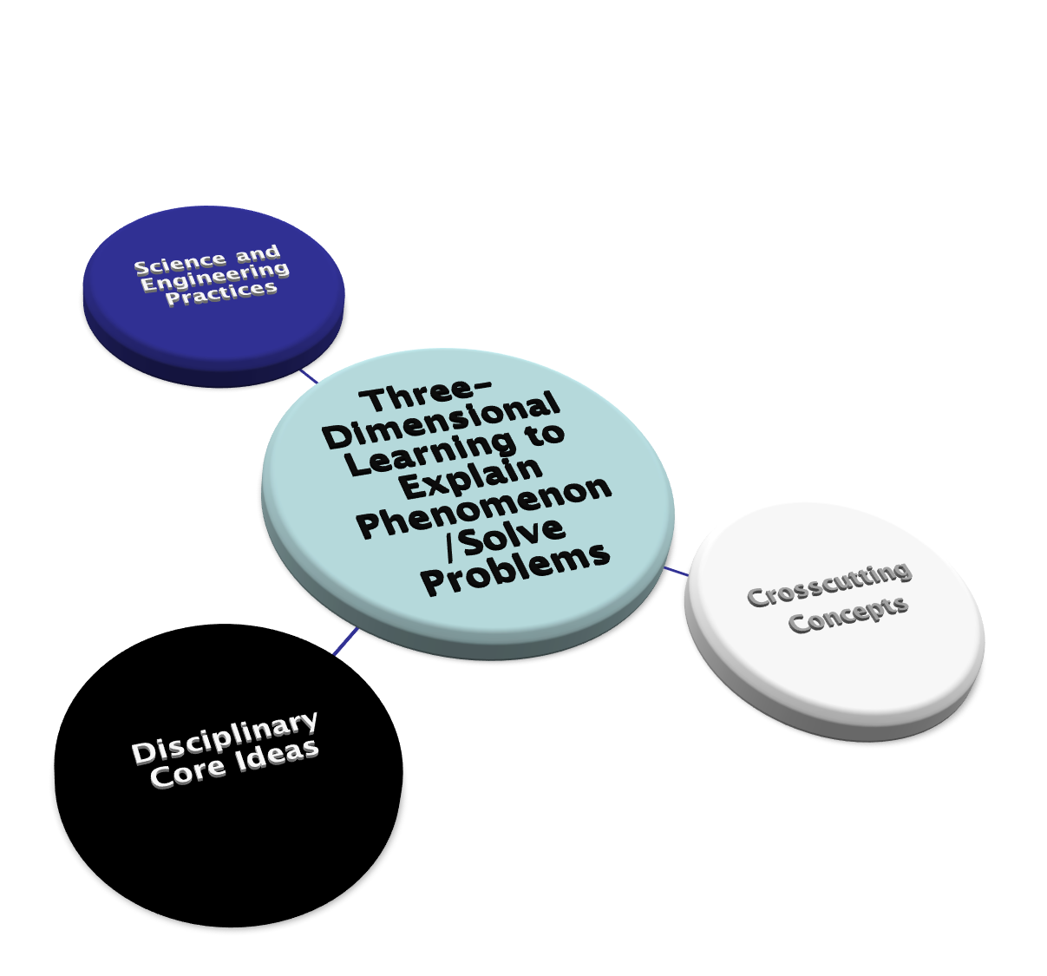
Three Dimensions of Science Learning Outlined in NRC Framework/Used to Frame NGSS
‹#›

Slide 10
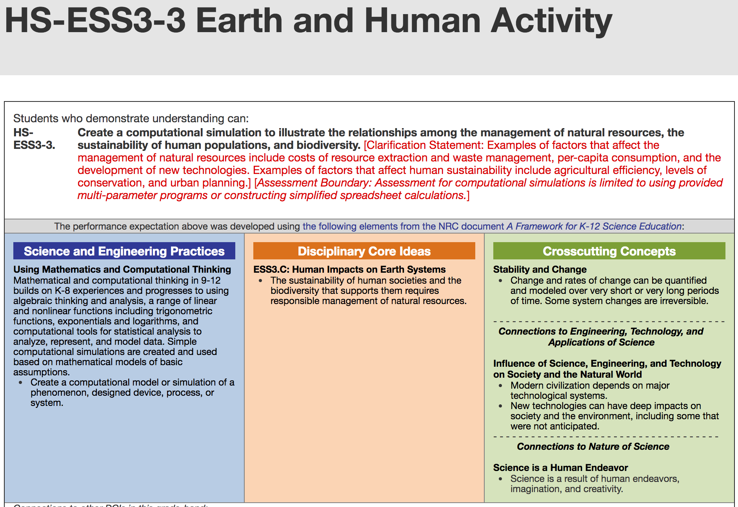
Integrating the Three Dimensions and
Performance Expectations
‹#›
Notes:
Performance expectations are “end points” that are assessed at the end.
Teachers role is to design instruction to get students to that end point.
Instruction should engage students in practices

Slide 11
Biggest Shifts in NGSS
Three-dimensional learning for the purpose of sensemaking through explaining phenomena or solving problems
Engaging in science and engineering practices to use disciplinary core ideas and crosscutting concepts to explain phenomenon or solve problems
Shifting from ‘learning about’ to ‘figuring out’!
‹#›
Notes:
Scientific Ideas Are Not Enough!
Understanding content is inextricably linked to engaging in practices. Simply “consuming” information leads to declarative, isolated ideas.
Science is both a body of knowledge and the process that develops and refines that body of knowledge. Understanding both the ideas and process is essential for progress in science.
The learning of science is similar: students cannot learn one without the other.

Slide 12
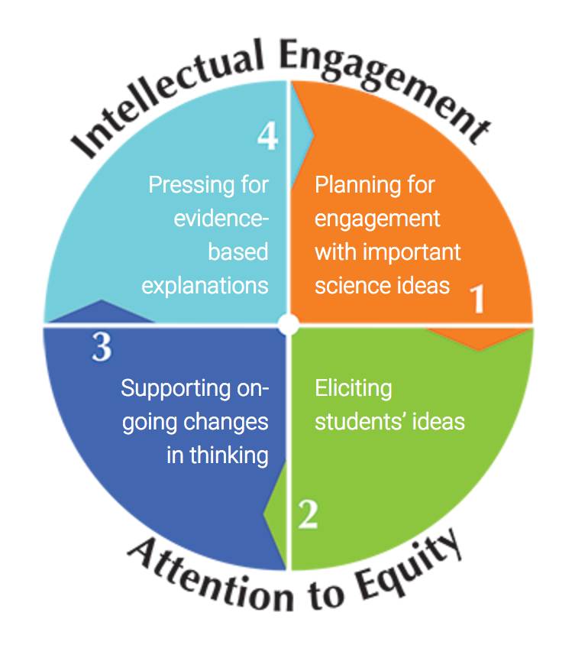
Ambitious Science Teaching
AST
Planning for engagement with important Ideas
Eliciting students’ Ideas
Supporting ongoing changes in thinking
Pressing for evidence- based explanations
‹#›
Notes:
Berland (2011) describes practices as the habits of mind and processes undertaken by communities of scientists as they work to develop explanations and arguments for explaining natural phenomena and/or leverage science for making informed decisions as citizens.
‹#›

Slide 13
Unit Structure:
Parts 1-4 from Stroupe and Windschitl’s (2015) framework for Ambitious Science Teaching
PART 1: Planning for engagement with important science ideas
PART 2: Eliciting Student ideas
PART 3: Supporting ongoing changes in thinking
PART 4: Pressing for evidence based explanations
PART 5: Incorporating Social Justice Issues
PART 6: Applying what we learned to a real world problem through engineering design
PART 7: Assessment of Learning

Slide 14
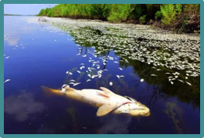
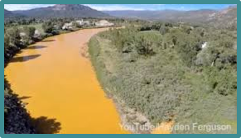
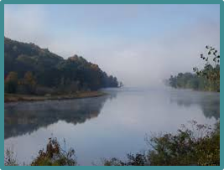
Starts with Phenomena!
A complex anchoring phenomenon is an occurrence or event that happen(ed) in our world
What is the state of your
local water resource and why?
‹#›
Notes:
‹#›

Slide 15
Unit Lesson Day 1
Put on your Learner Hat!
Link to Scientist Notebook Google Doc
Discuss Collaborative Project Norms
Make a Copy
https://goo.gl/KFCCmN

Slide 16
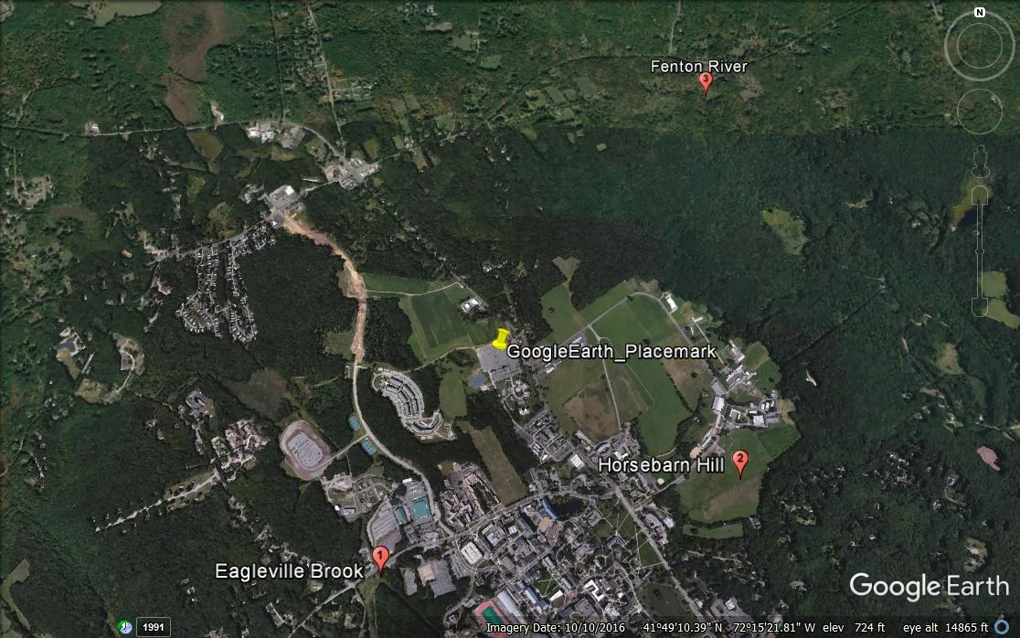
What do you predict is the state of each water resource and why?
‹#›
Notes:
Present phenomena: aerial photos of 3 water resources located close to the UCONN campus (1 min)
Point out overall location relative to each. Then show next slide of each and point out that they have links in their google Scientists notebook

Slide 17
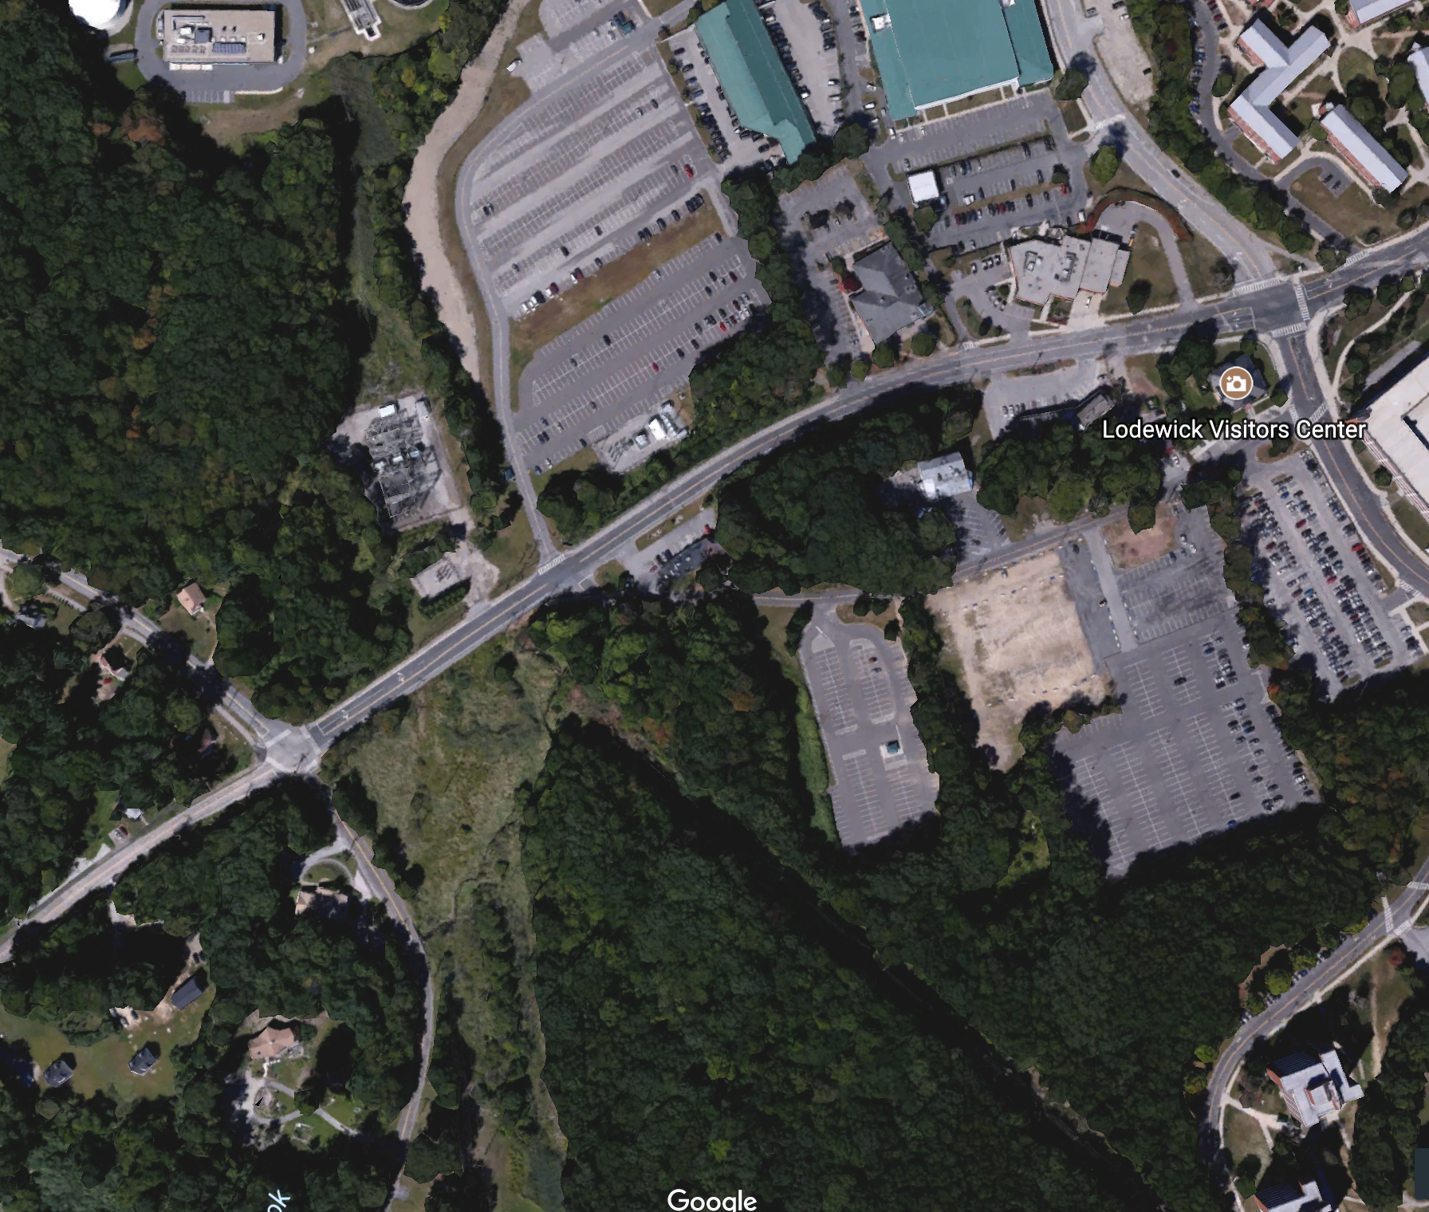
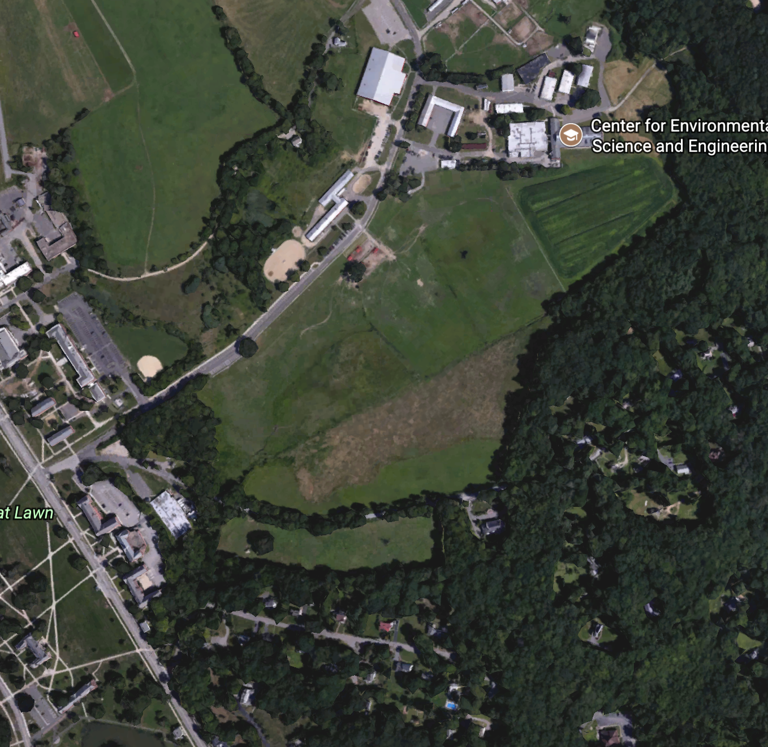
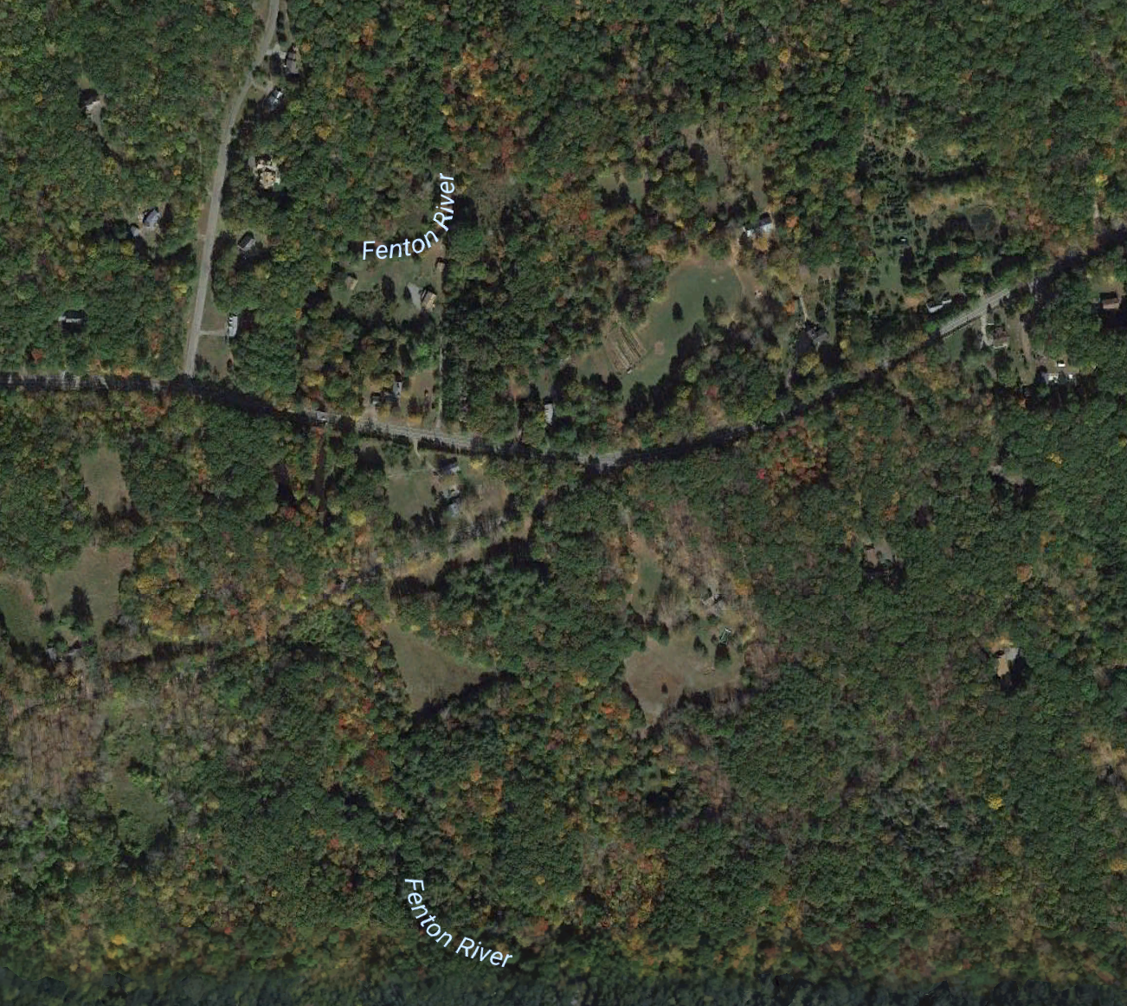
1. Eagleville Brook
2. Roberts Brook
(Horsebarn Hill)
3. Fenton River
‹#›
Notes:
1. Think Pair Share
2. Students write individual initial explanations about the state of each water resource and why in their scientist notebook. (3 min)
3. Students in small groups share initial ideas and brainstorm how they could answer the question (5 min)
‹#›

Slide 18
Gotta Have List:
A list of ideas that are important to include in answers to the question about the phenomenon.
All contributions will be recorded on the board to start.
Once everyone’s ideas have been shared, the class will evaluate the list and determine what they agree should be included in everyone’s initial models.
Notes:
3. Whole group discussion to create initial Gotta Have List (5 min)

Slide 19
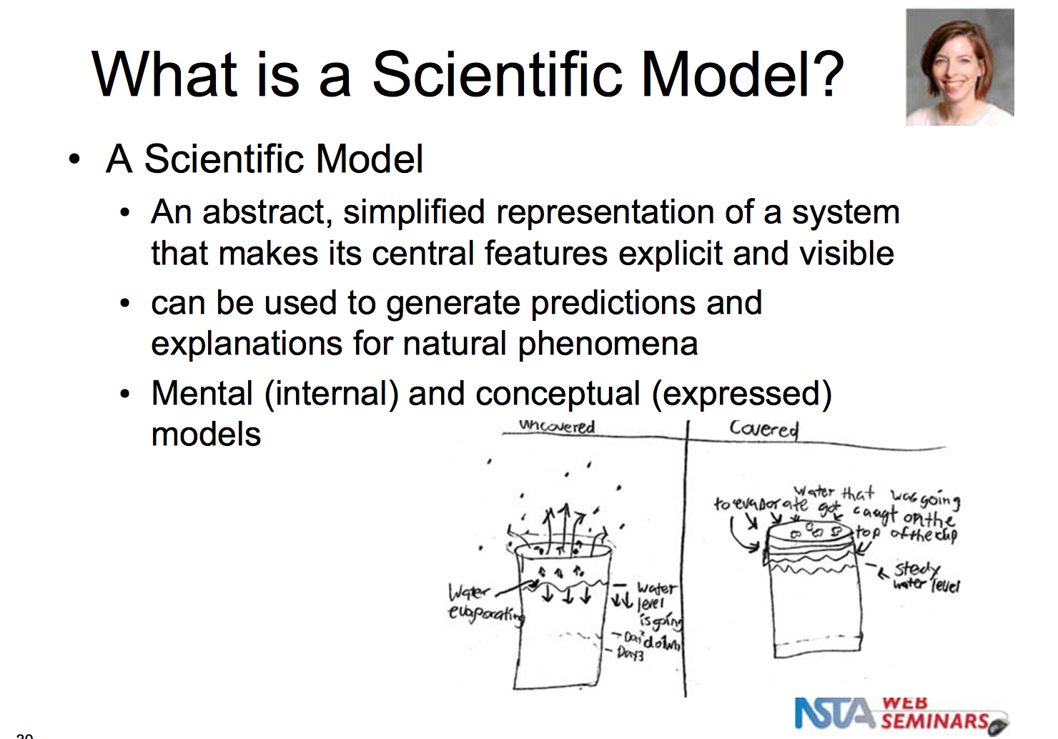
Science and Engineering Practice (SEP) Modeling
‹#›
Notes:
1. Review scientific model - Explanatory Model - important that it shows the mechanism for the phenomenon – the why it happens. Use pictures, arrows, words (3 min)

Slide 20
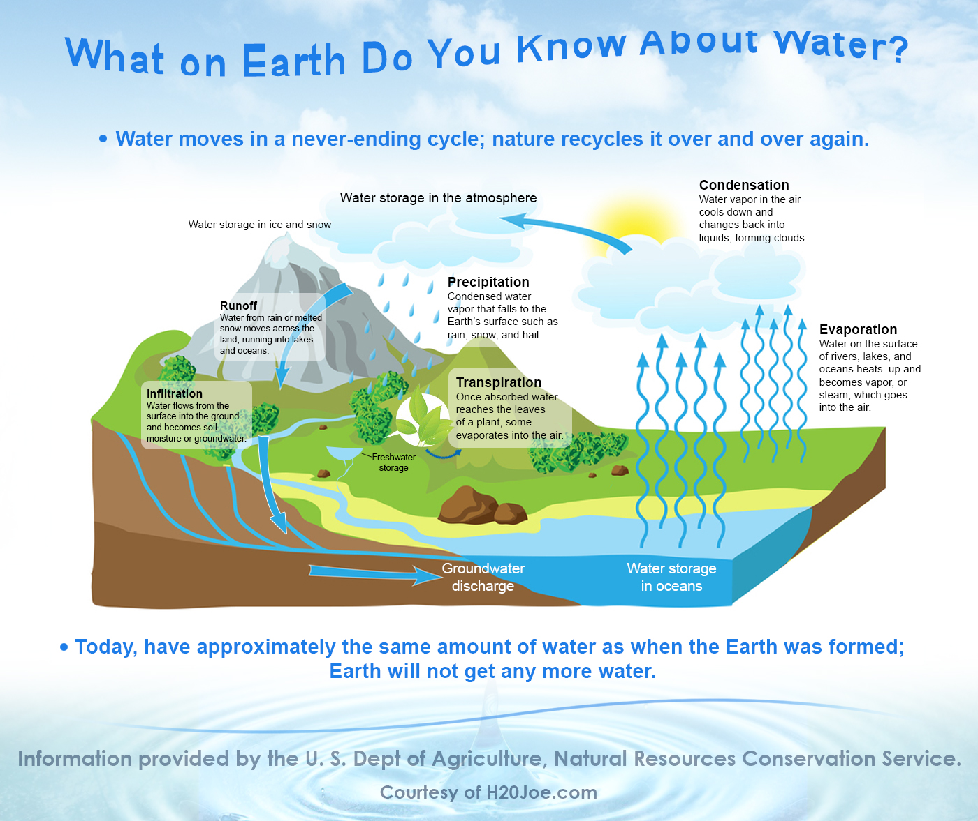
Notes:
2. Student groups work on initial model of 3 water resources (15 min)

Slide 21
What is the state of Your local water resource and Why?
1. Create Models (15 min)
2. Post & Gallery Walk (5 min)
3. Discussion comparing models
and ideas (10 min)
4. Driving Question Board (5 min)
Notes:
3. Groups post models and gallery walk (5 min)
4. Class discussion comparing models and ideas. What would you need to know to answer the question? (10 min) What questions will need to be answered - Create Driving Question Board
5. Preview of next day’s lesson – Water quality testing (1 min)

Slide 22
Preview of Next Day’s Lesson
IMG_4409.JPG
IMG_4409.JPG
Field trip to sites
Or bringing water and pictures of site to classroom
(Notes for workshop - make sure at least 1 person in each team goes to each site)

Slide 23
Learner Hat: (10 min)
Summary Chart
Day 1
Teacher Hat: (20 min)
Review Lessons 1-3 with Notes Break
Notes:
Complete summary chart together. (15 min)
Time to jot down notes
Last few minutes share notes and remind them it is OK to copy good ideas
Day

Slide 24
Day 2
Learner Hat:
Summary Chart (15 min)
Teacher Hat (60 mim)
Review Lessons 4-6; 13+ with Notes Break
Notes:
Complete summary chart together. (15 min)
Time to jot down notes
Last few minutes share notes and remind them it is OK to copy good ideas
Day

Slide 25
Day 3
Learner Hat:
Summary Chart (15 min)
Teacher Hat (30 min)
Review Lessons 7-12 with Notes Break
Notes:
Complete summary chart together. (15 min)
Time to jot down notes
Last few minutes share notes and remind them it is OK to copy good ideas
Day

Slide 26
Initial Gotta Have List
Eagleville | Horsebarn | Fenton

Slide 27
Create Final Gotta Have List
Revise initial model with Gotta Have List and Summary Charts (45 min)
PUT ON YOUR LEARNER HAT
Notes:
Complete summary chart together. (15 min)
Time to jot down notes
Last few minutes share notes and remind them it is OK to copy good ideas
Revise initial models

Slide 28
Human Impact on Local Water Resources
Unit
Unit Part 1 = AST Stage 1
Planning for engagement with important Ideas
Notes:
PART 1: PLANNING A UNIT AROUND “BIG SCIENCE IDEAS”
DCIs and PEs and Framework
Anchoring Phenomenon
Crosscutting concepts
Provide a Target Explanation
Develop Driving Questions
Construct example of final model
Identify concepts (scientific principles) within target explanation
Choose classroom activities to help students understand these scientific principles
Identify previous and future ideas and reasoning

Slide 29
Unit Part 2 = AST Stage 2
Eliciting Students’ Ideas
Lesson 1: Initial Modeling Lesson and Discourse
Eliciting students’ initial scientific hypotheses in order to plan for further instruction. The goal of this discourse is to draw out students’ understandings of a phenomenon (e.g. a bicycle rusting in the backyard) that is related to an important scientific idea. After the lesson we analyze students’ ways of talking about it in order to adapt upcoming learning experiences
(AST Discourse-Primer, 2015, p. 7.)

Slide 30
Unit Part 3 = AST Stage 3
Supporting ongoing changes in thinking
Lessons 2 - 10
• Making sense of data/information. The goal here is to help students recognize patterns in data, critique the quality of data, and to propose why these patterns exist. What, for example, is going on at the unobservable level that explains our observations?
• Connecting activities with big scientific ideas. The goal of this practice is to combine data-collection activities with readings and conversation in order to advance students’ understanding of a broader natural phenomenon.
(AST Discourse-Primer, 2015, p. 7.)
Notes:
This conversation is different from the previous one, in that students are not trying to explain the outcome of an activity, but to relate the activity to a bigger science idea or puzzle that the unit is framed around.

Slide 31
Part 4 = AST Stage 4
Pressing student to construct
Evidence-Based Statements
Lessons 11 & 12
This discourse is designed to happen near the end of a unit, but elements of this conversation can also happen any time the teacher is trying to get students to talk about evidence.
The goal of this discourse is to assist students in using multiple forms of evidence, gathered during a unit, to construct comprehensive explanations for a phenomenon that has been the focus of the unit.

Slide 32
Part 5: INCORPORATING SOCIAL JUSTICE INTO UNIT WITH AN EXPLORATION OF ENVIRONMENTAL RACISM AND ECOJUSTICE
Lessons 13 - 15 & 24 - 26
Water is Life
Teacher EcoJustice Toolkit Website
And companion Social Justice lessons

Slide 33
Part 6: Incorporating Engineering Design
Researching Low Impact Development (LID) to protect or improve these resources
Lessons 16 - 23
Initiating Design of LID project for school’s water resource
Designing solution and building prototype[optional] and Presenting

Slide 34
Part 7: Unit Assessment of Learning
These five steps were designed to help teams develop assessment tasks.
Step 1: Define what you will assess by analyzing relevant sections of A Framework for K-12 Science Education and crafting learning claims.
Step 2: Brainstorm Possible Scenarios for Eliciting Student Understanding.
Step 3: Use Task Formats to Build Questions to Engage Students with the Scenario.
Step 4: Imagine the Range of Possible Student Responses to the Questions.
Step 5: Share, Review, and Revise.
This NGSS Assessment Development Template was developed in alignment with
Creative Commons by the Research + Practice Collaboratory, 2016.

Slide 35
Adapt Unit to Your Local Water Resource
Model My Watershed
Find Sites (aerial view with Google Maps)
Revise Target Explanation for your sites
Create an example of the final model you want your students to create
Check concepts with target explanation
Check activities
Create assessment

