Slide 1
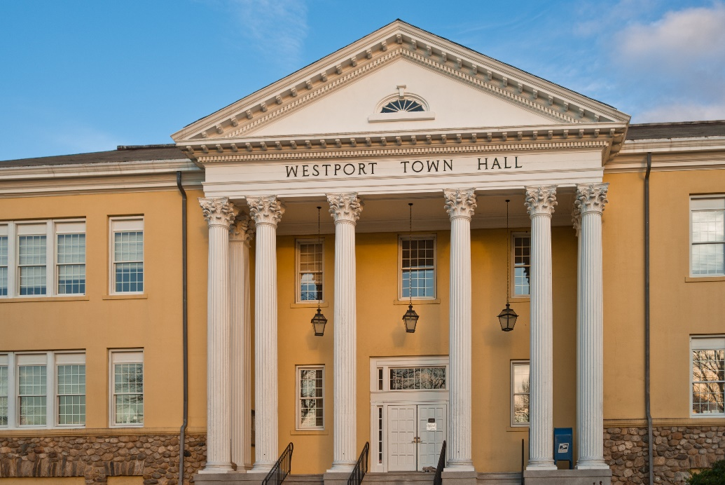
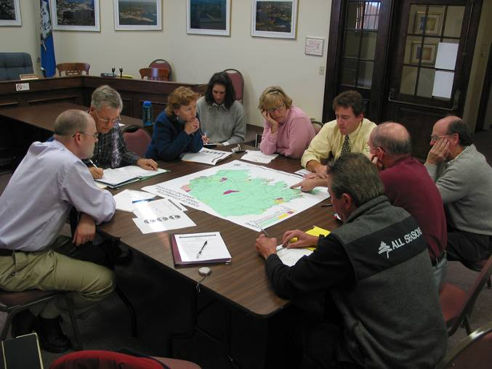
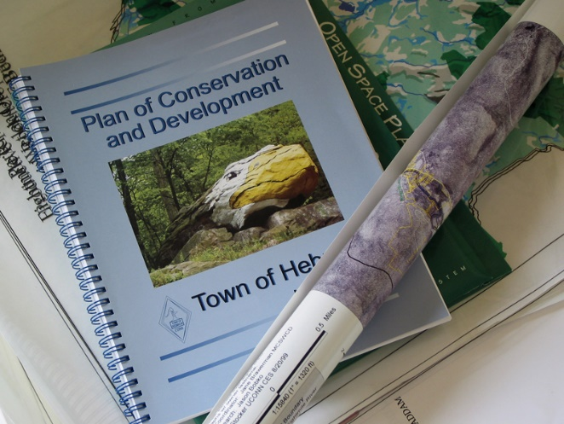
The Human Element:
Water & Land Use
Regulatory Frameworks
Dave Dickson
NRCA Teacher Professional Learning
8-17-17

Slide 2
What’s Ahead
From Point A to Nonpoint B
Land Use Regulation Quiz
State of Land Use Regulation in CT

Slide 3
Open your laptops/phones
In a browser on your phone or computer, go to:
    http://pollev.com/daviddickson371

Slide 4

Testing the System
Notes:
Describe your summer in two words or less
https://www.polleverywhere.com/free_text_polls/4un9WGEQxKRPiXO

Slide 5
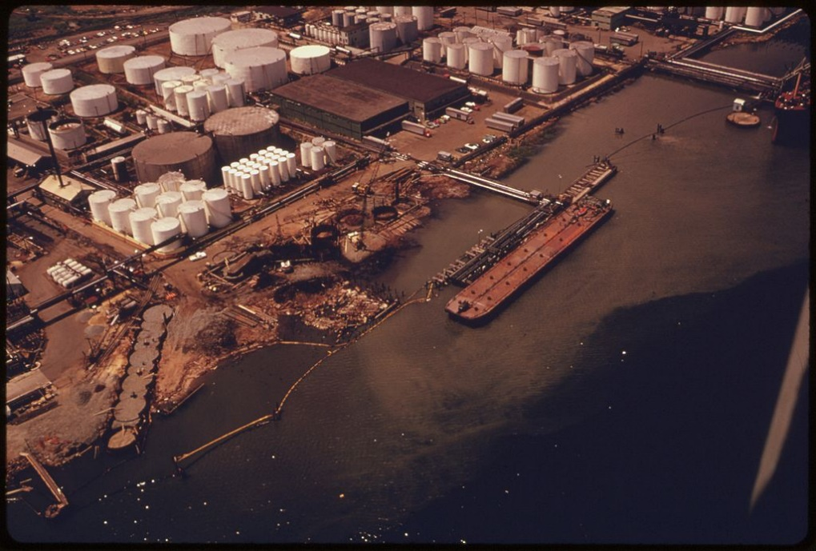
Human Relationship to Water Pre-1970
Dilution the solution - direct discharge
Federal Water Pollution Control Act (1948)
  no limits
  authority left to states
Largely unchecked industrial, agricultural & municipal discharges
Water quality not concern
By Alexander, Hope, Photographer (NARA record: 8452212) (U.S. National Archives and Records Administration) [Public domain], via Wikimedia Commons

Slide 6
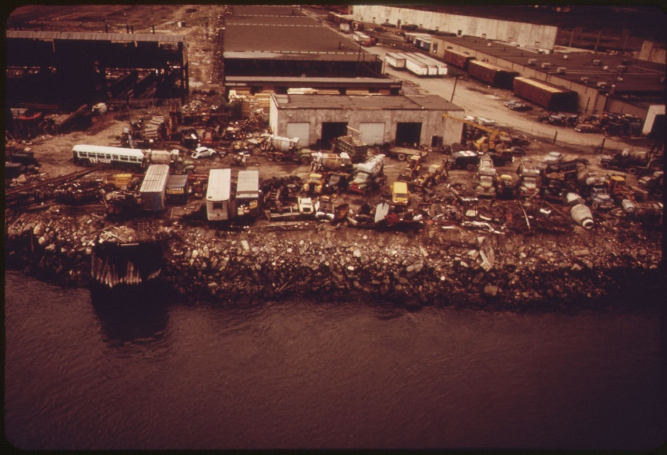
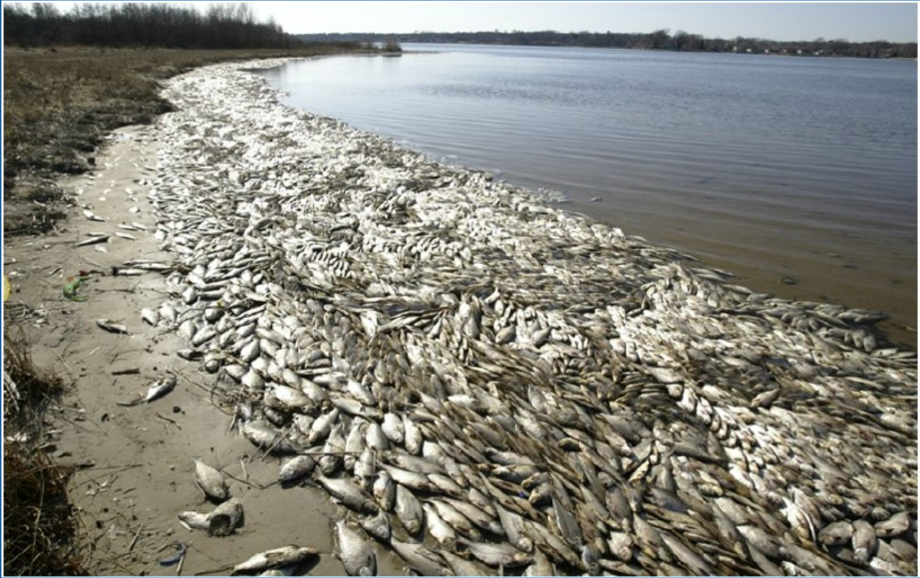
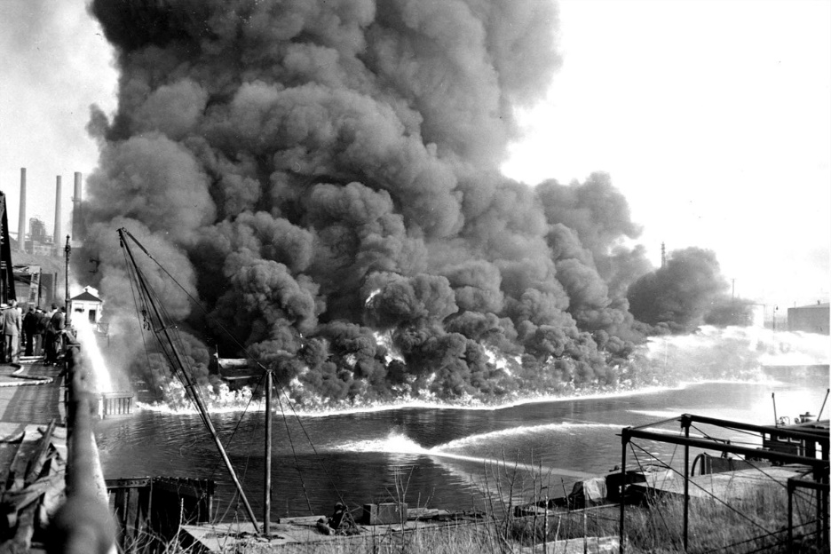
1969 Water Pollution Wake Up Call
Bacteria levels in Hudson River 170x safe limits
26 million fish killed in Lake Thonotosassa
Santa Barbara oil spill
Cuyahoga River catches fire
Photo: Cleveland State University Library
By USGS - Mary C. Rabbittt, 1989.

Slide 7
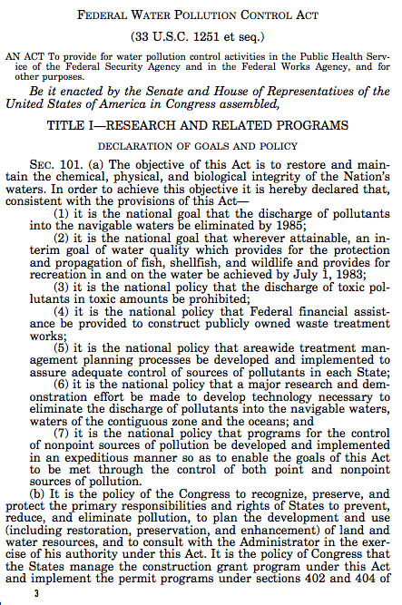
Response: Clean Water Act (1972)
shifted primary authority to federal gov’t
Limits on point source pollution (NPDES permits)
Regulate & assist wastewater treatment plants
maintain the integrity of wetlands
technology based

Slide 8
Progress?
Goals
Restore & maintain nation’s waters
Make all waters fishable/swimmable by 1983
Zero water pollution discharge by 1985
Prohibit discharge of toxic amounts of toxic substances
Results
Largely considered a success – no more burning rivers
U.S. Waters meeting standards increased from 35% to 65%
Drinking water systems meeting standards increased from 70% to 91%
Reclaimed waterfront
WQ now national interest
Notes:
https://www.mnn.com/earth-matters/wilderness-resources/blogs/the-clean-water-act-turns-40

Slide 9
Progress?
Goals
Restore & maintain nation’s waters
Make all waters fishable/swimmable by 1983
Zero water pollution discharge by 1985
Prohibit discharge of toxic amounts of toxic substances
However . . .
35-40% of US waters still unfit for fishing or swimming
Discharges have not stopped–although now regulated, monitored and fined
¼ of all permitees operating w/o current permits
Other sources of pollution not addressed
Notes:
https://www.mnn.com/earth-matters/wilderness-resources/blogs/the-clean-water-act-turns-40

Slide 10
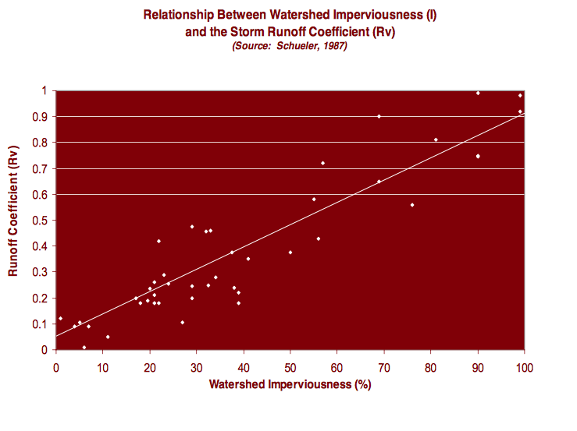
NPS Pollution– Linking Land Use to WQ

Slide 11
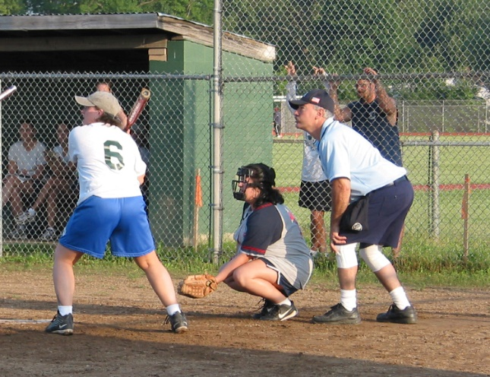
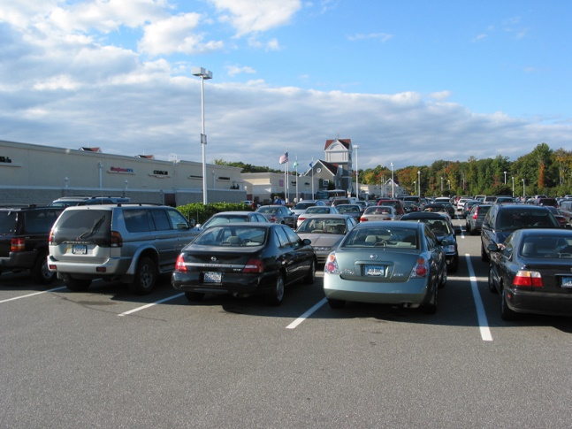
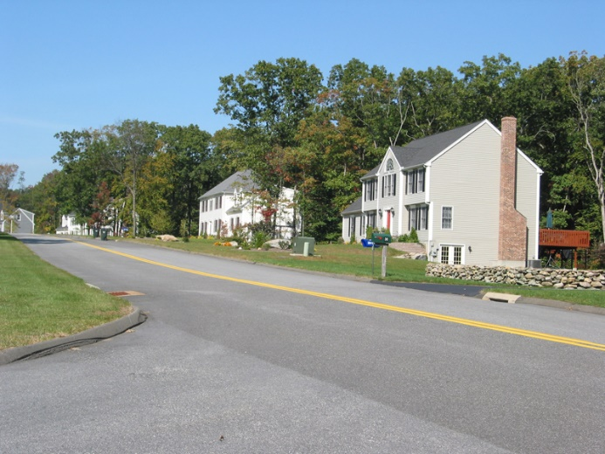

INTENSITY OF LAND USE
WATER QUALITY PROBLEMS
AMOUNT OF IMPERVIOUS SURFACE
Notes:
The Trend Toward Imperviousness
As we move from the less to more intense land covers, the potential water quality problems increase. And the common thread throughout is the increasing amount of impervious surface.
PHOTO: First on left, used with permission from the Alabama NEMO Program.

Slide 12
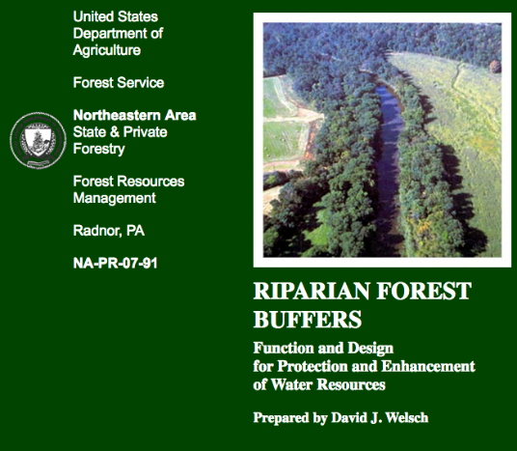
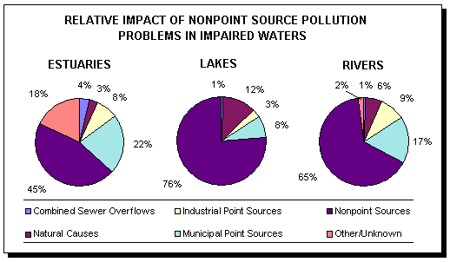
NPS Pollution– Linking Land Use to WQ
“ . .. nonpoint source pollutants, which are typically dispersed in origin, have increased in relative importance and now account for more than 50% of the pollution in our nation's waters.”
By David J. Welsch, for the United States Department of Agriculture, 1991, [Public domain], via Wikimedia Commons

Slide 13
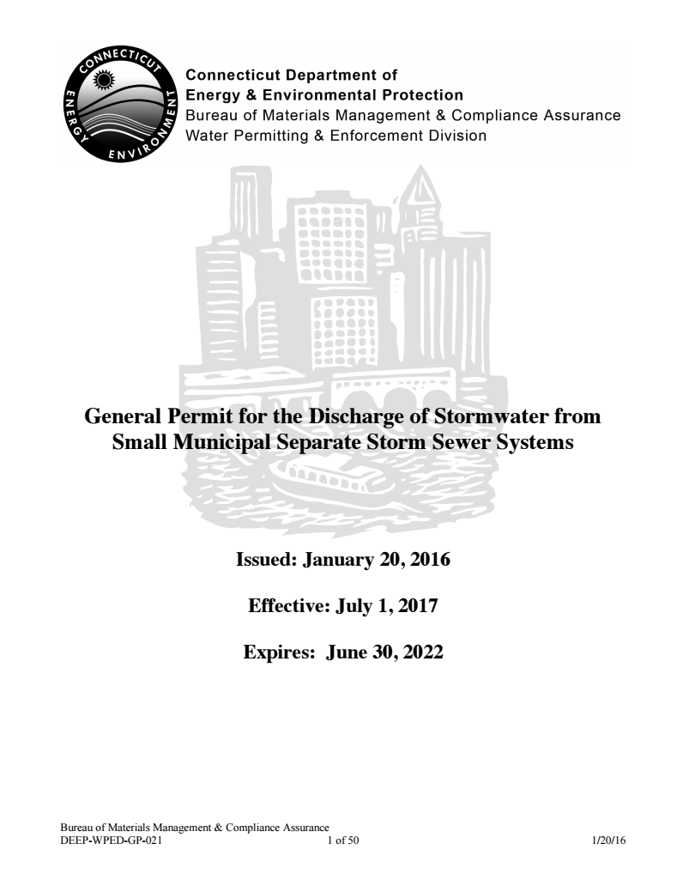
Water Quality Act of 1987
Recognize the land use & WQ connection
Grants to address NPS (319)
Permits required for:
  Industrial stormwater discharges
  Municipal separate storm sewer systems (MS4)
TMDLs
(Agricultural discharges still exempt)
U.S. EPA

Slide 14
Regulate This!
Residential (fertilizer, pesticides, pet waste, cleaners, septics)
Construction (sediment, chemicals, oil, etc.)
Roads/Parking lots (salt, sand, oil, grease, brake dust, trash, etc.)
Agricultural (sediment, manure, insecticides, etc.)

Slide 15
NPS Pollution – How do we regulate it?
Diffuse sources harder to regulate, monitor
Human behavior change needed, but difficult
Have more control over how we developed & develop our communities
Bottom line: Land use planning & site design is critical

Slide 16
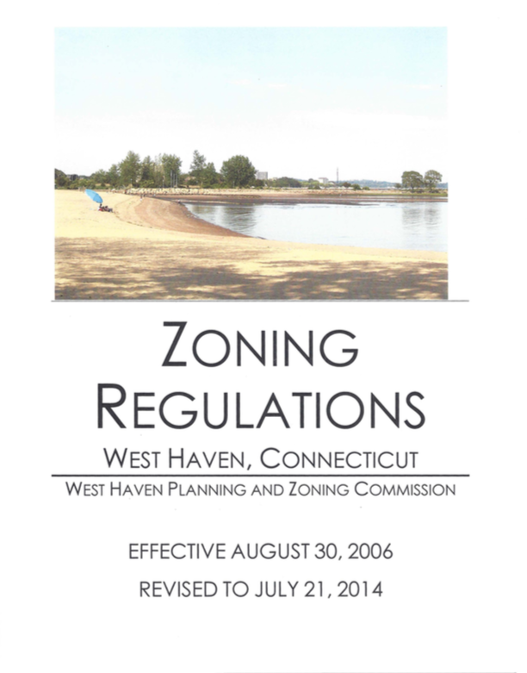
Changing How We Develop & Manage Stormwater
Old Way - flooding focused
New Way – flooding & pollution prevention

Slide 17
What do you know about how we change land use regulations?
In a browser on your phone or computer, go to:
    http://pollev.com/daviddickson371

Slide 18
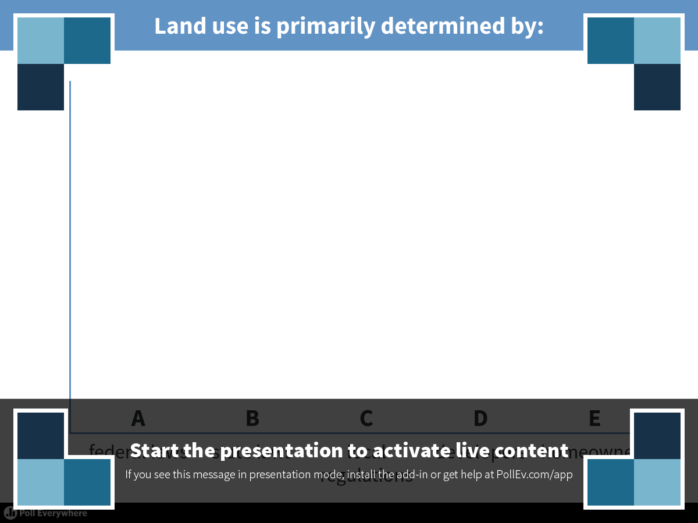
Notes:
Land use is primarily determined by:
https://www.polleverywhere.com/multiple_choice_polls/pnM8TxJmfchl4hA

Slide 19
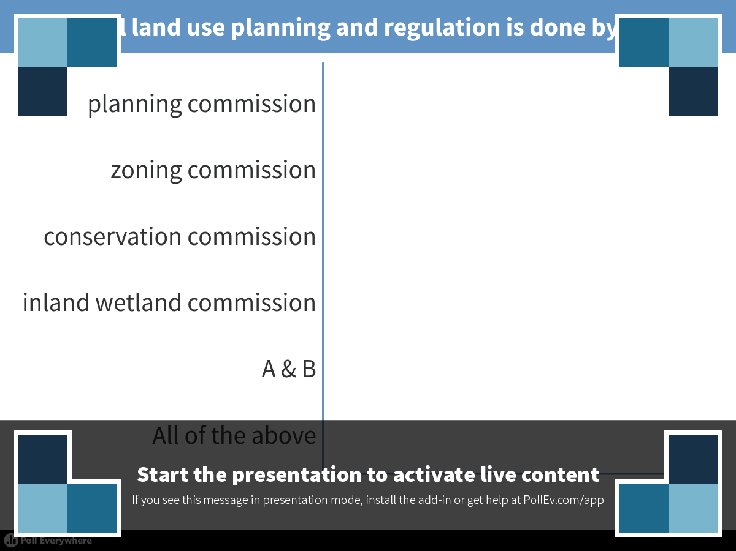
Notes:
Local land use planning and regulation is done by the:
https://www.polleverywhere.com/multiple_choice_polls/FcMnGIC1VghkIp3

Slide 20
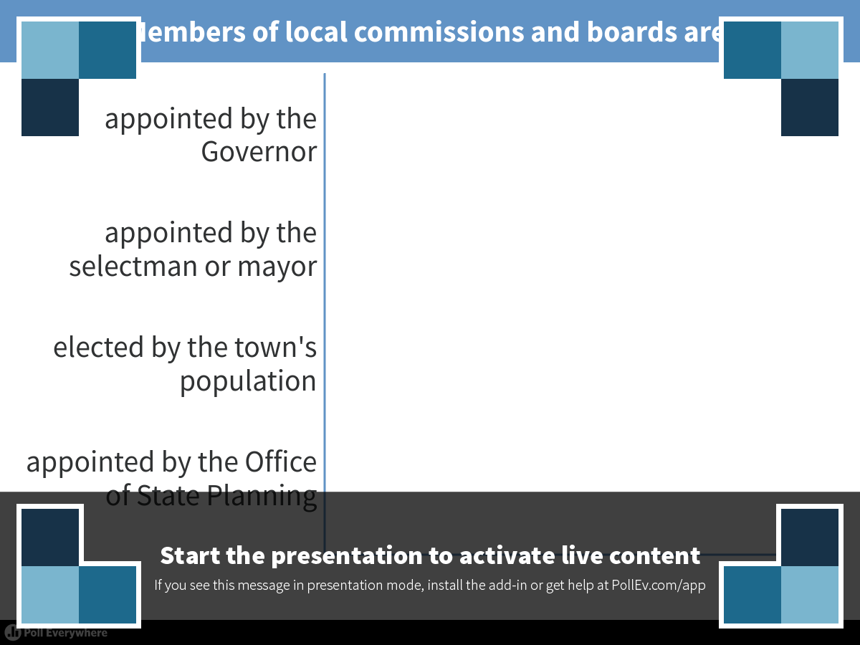
Notes:
Members of local commissions and boards are:
https://www.polleverywhere.com/multiple_choice_polls/VMYpQu4ollio4OV

Slide 21
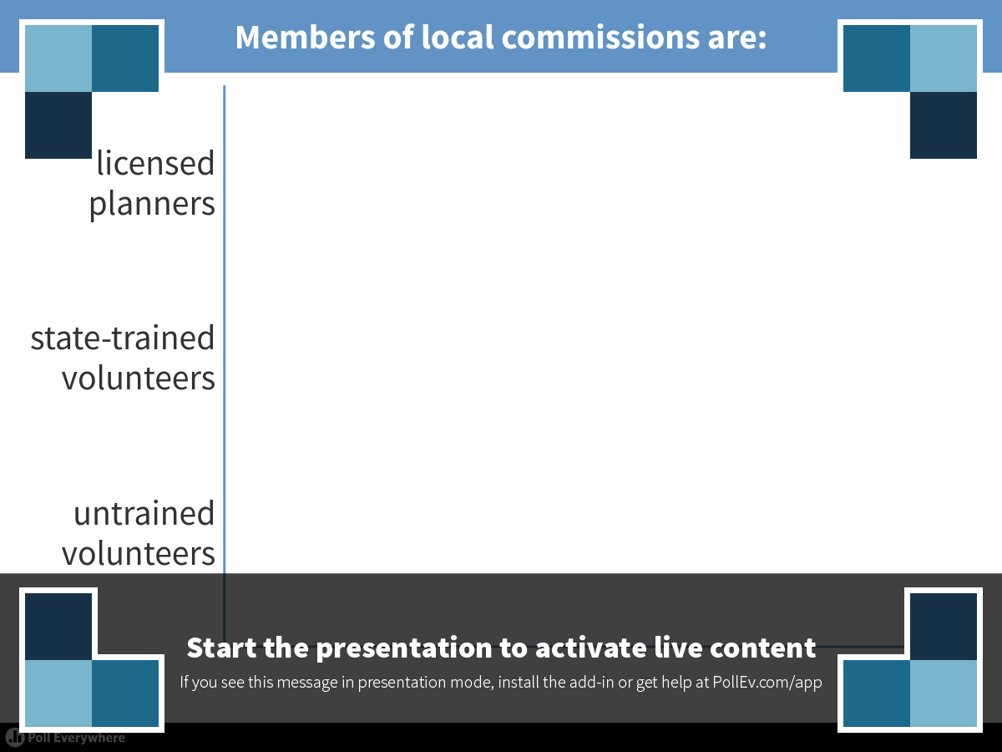
Notes:
Members of local commissions are:
https://www.polleverywhere.com/multiple_choice_polls/aujLOo6jvHpNXUk

Slide 22
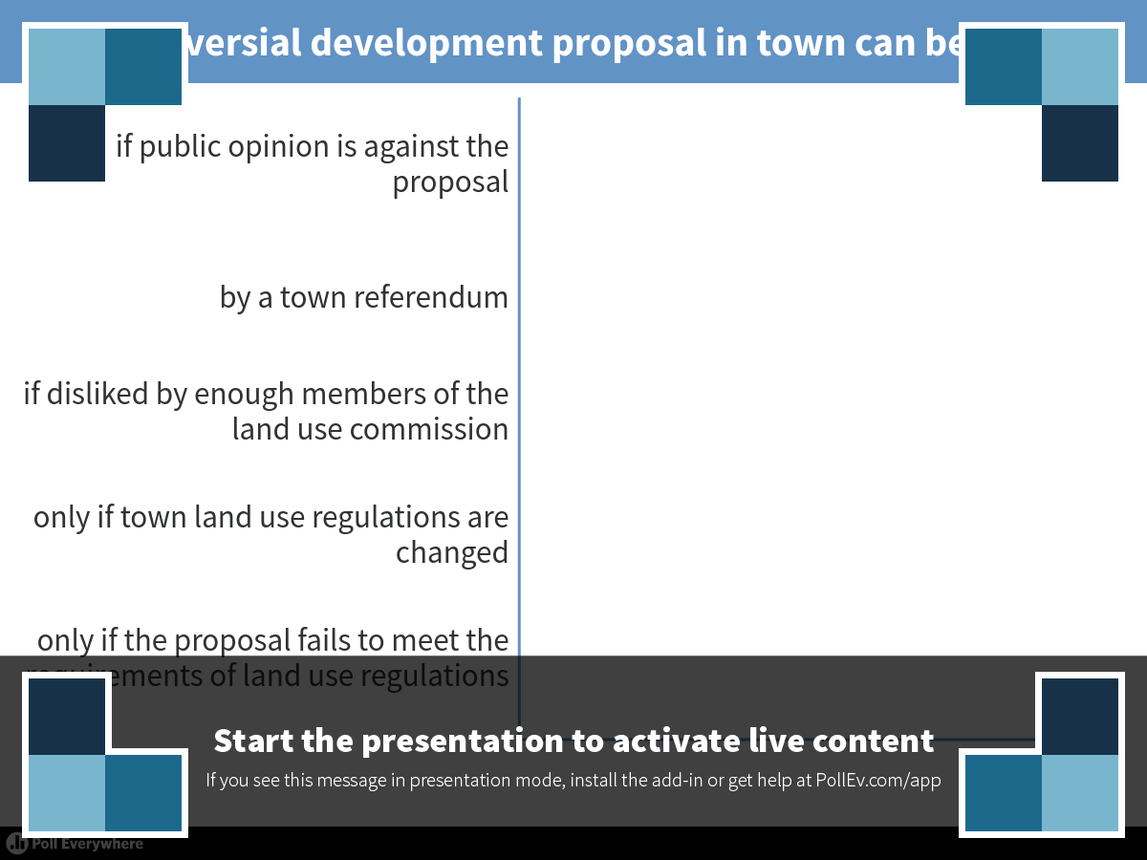
Notes:
A controversial development proposal in town can be denied:
https://www.polleverywhere.com/multiple_choice_polls/DRPR57ykVk6bBzi

Slide 23
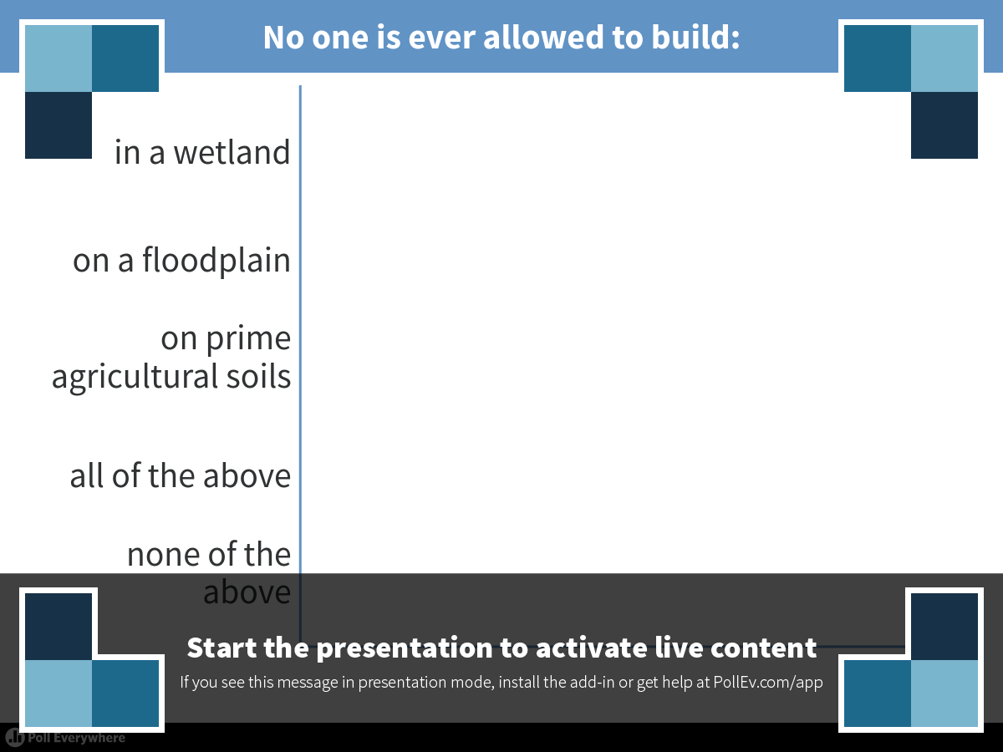
Notes:
No one is ever allowed to build:
https://www.polleverywhere.com/multiple_choice_polls/pJVVfsFfER9AZ7Q

Slide 24
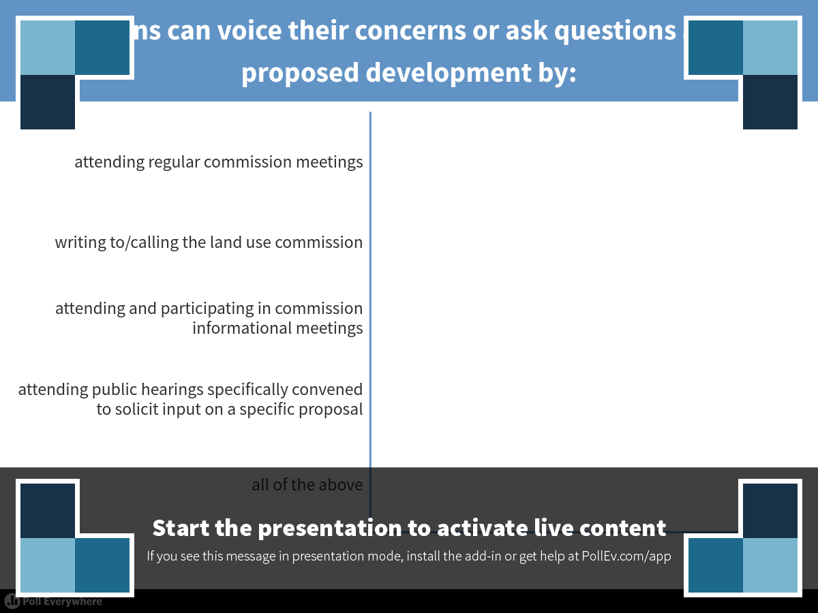
Notes:
Citizens can voice their concerns or ask questions about proposed development by:
https://www.polleverywhere.com/multiple_choice_polls/UPqWStWIAae7Zpo

Slide 25
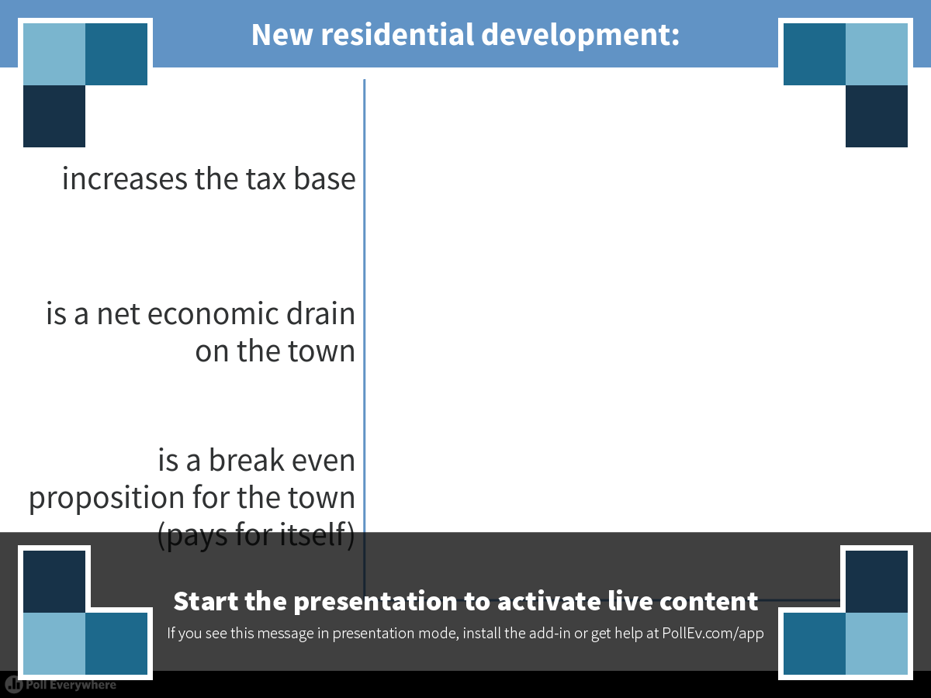
Notes:
New residential development:
https://www.polleverywhere.com/multiple_choice_polls/NZ6vSPOmL6VZTA2

Slide 26
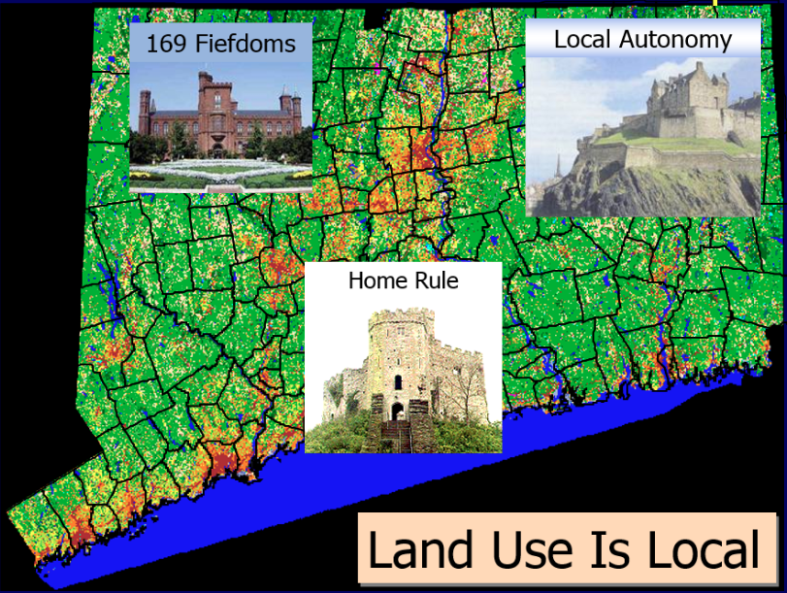
In Sum - Land Use in CT
169 Fiefdoms
No County Government
No State Planning Office
No State GIS
½ towns no full time planning staff

Slide 27
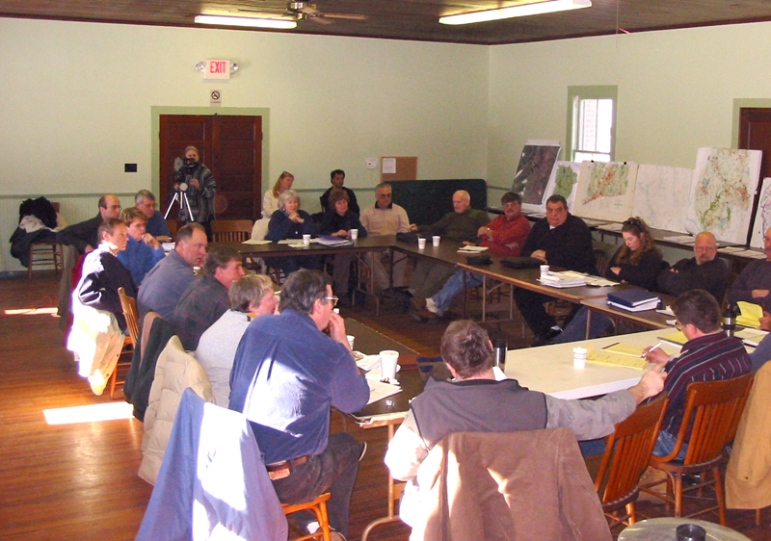
In Sum - Land Use Comissioners
Untrained volunteers
Complex issues
Legal mandates
They establish regulations
  Where to develop
  How to develop
Decide if followed
Power limited by their regulations
High turnover

Slide 28
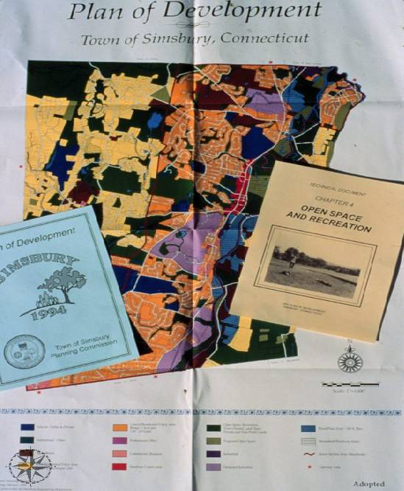
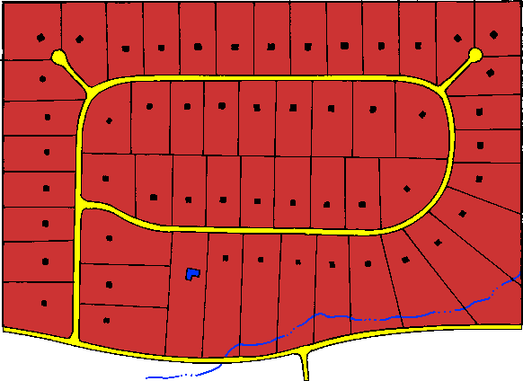
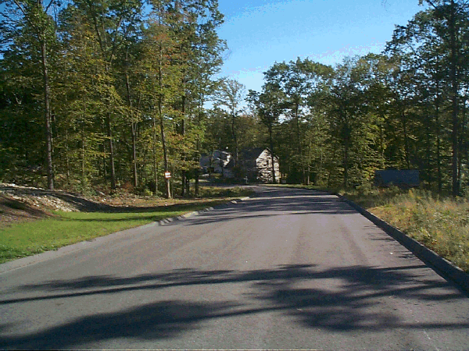
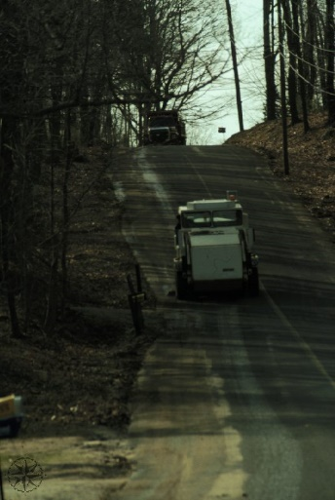
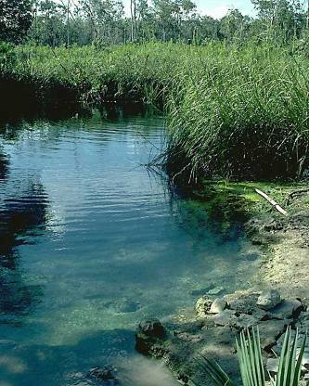
Land Use Regulatory Process
zoning
subdivision
wetlands
policy
Notes:
The plan will lay the groundwork for instituting changes to policies and regulations. The plan outlines the rationale for the regulations by describing in plain language what public purpose is being protected or promoted

Slide 29

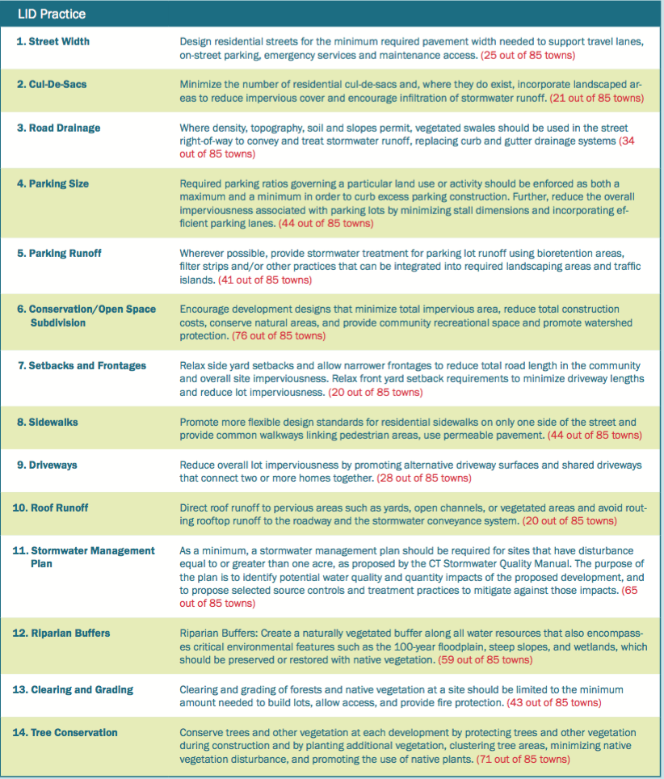
Status of Land Use Regs. in CT

Slide 30
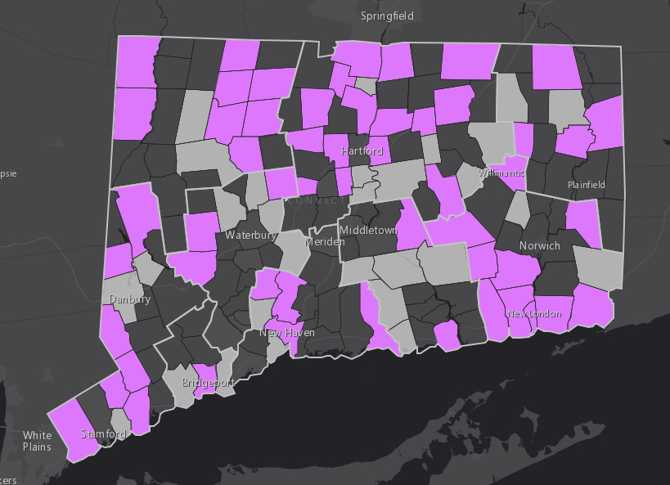
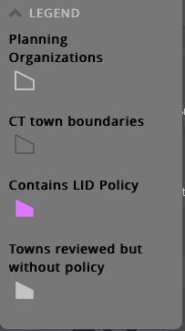
General Support for LID
54 of 85 towns mention LID in regs

Slide 31
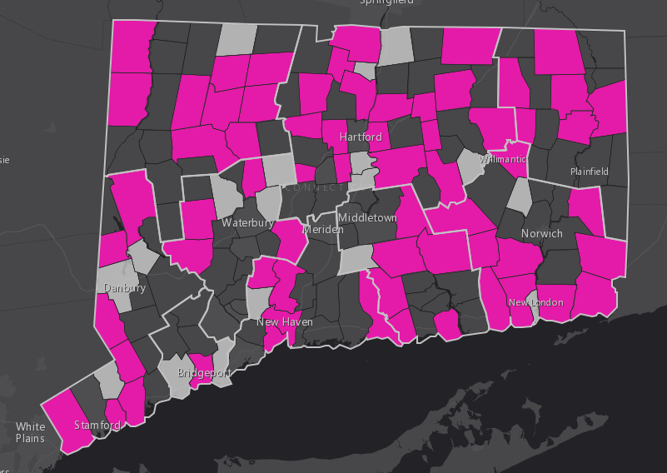
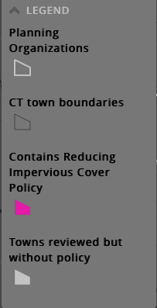
Support for Reducing Impervious Surfaces
65 of 85 towns mention
reducing impervious surfaces

Slide 32

Specific Regulations
landscape scale
site scale

Slide 33
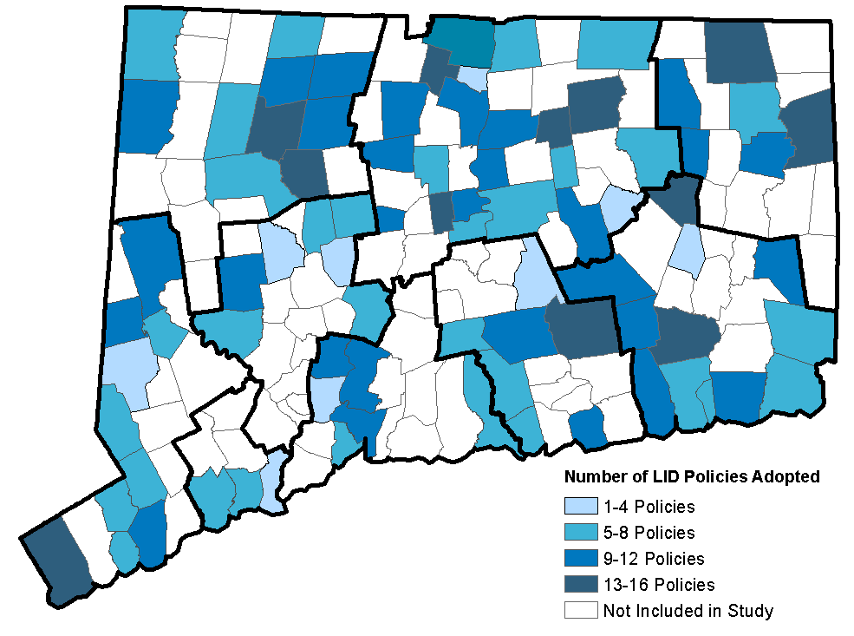
Policies Adopted by Town

Slide 34
Drivers & Barriers to Change
Does your community encourage/require the use of low impact development or green infrastructure to manage stormwater? If so, in what ways?
What are the factors driving your community to encourage or not encourage LID?
What are the biggest obstacles to implementing LID regulations or practices in your town?

Slide 35
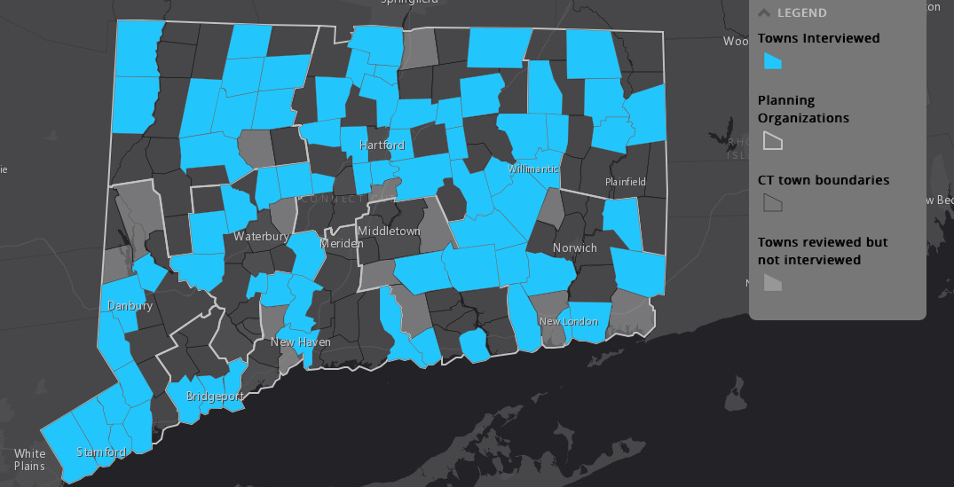
Who’d we talk to?
Interviewed 78 people in 74 of 85 towns reviewed

Slide 36
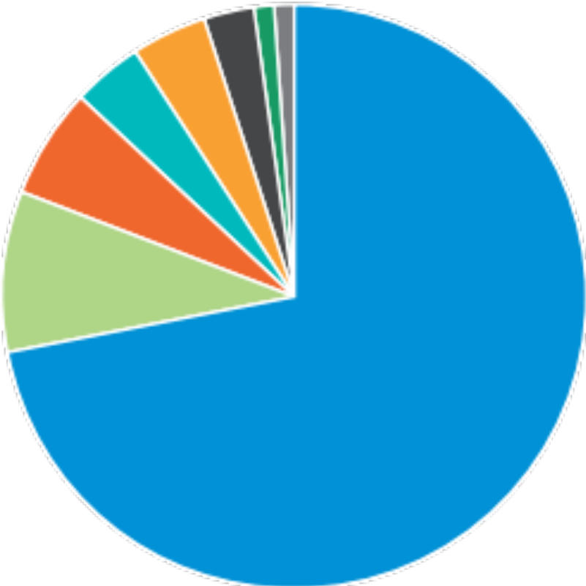
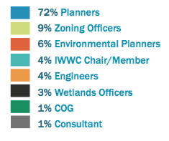
Who’d we talk to?
78 interviews over 2 months

Slide 37
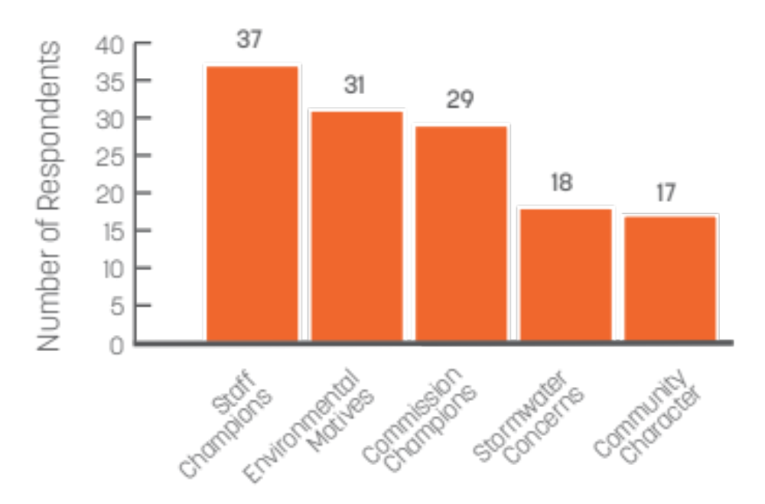
Top 5 LID Drivers

Slide 38
All LID Drivers

Slide 39
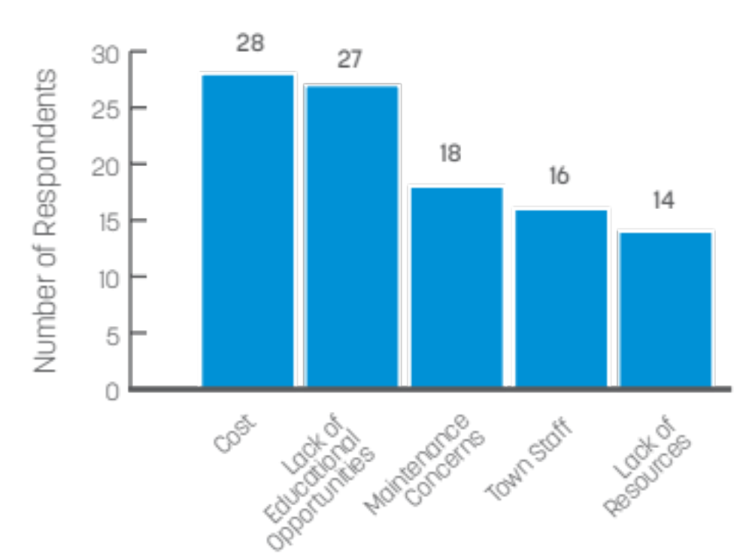
Top 5 LID Barriers

Slide 40
LID Barriers
Cost: to developers/applicants, to town, to residents
Lack of ed: commissioners, community/homeowners, contractors, developers, nurseries, private engineers, town engineers, planners, staff
Maintenance: difficult to keep track of LID, maintenance concerns

Slide 41
LID Barriers
Town staff: lack of coordination between planning and public works, planner, public safety (fire department, etc.), public works, town engineer
Lack of resources: lack of funding/resources, no in-house engineer, time constrains (Staff/Volunteers)

Slide 42
All LID Barriers

Slide 43
State of LID StoryMap
http://s.uconn.edu/stateoflid

Slide 44

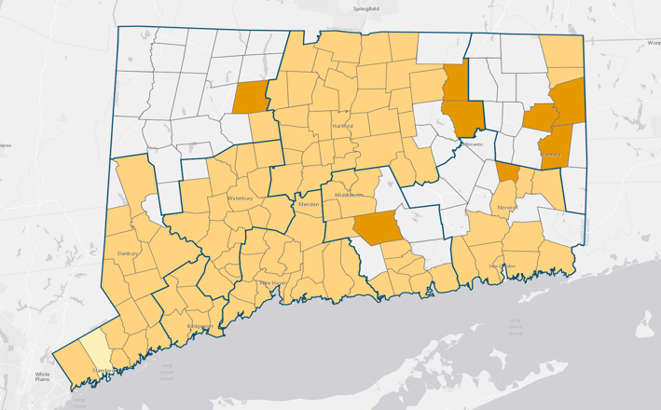
Everything about to change
121 of 169 towns

Slide 45
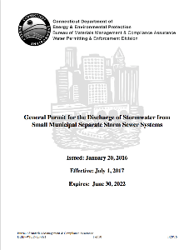
Towns now required to:
eliminate barriers to implementing LID in land use regulations
require new development proposals to consider LID 1st
reduce existing impervious surfaces
require new development to retain stormwater on site

Slide 46
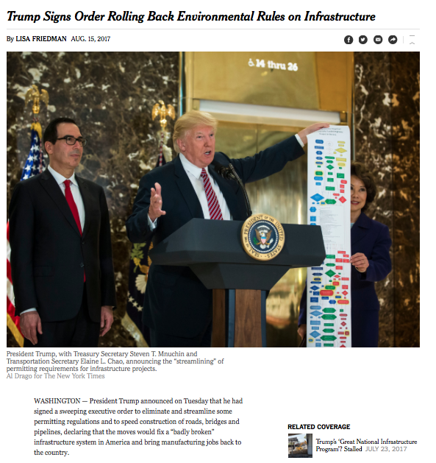
So change is coming, but …

Slide 47
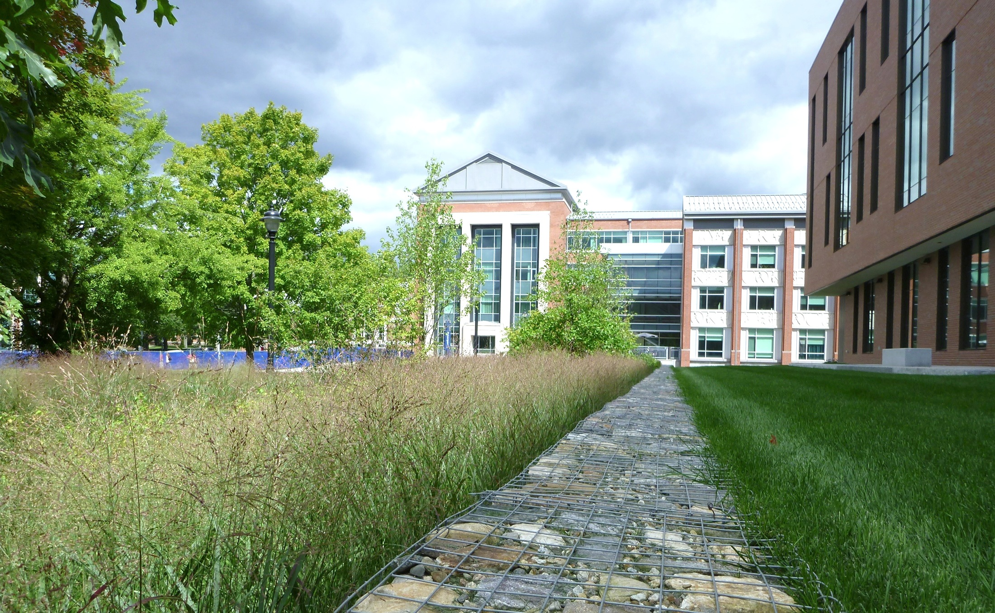
Thanks
David Dickson
david.dickson@uconn.edu
http://clear.uconn.edu

